Slide 1

Discrete Stochastic Processes
Lecture 07
________________________________________________________________________________________
2020 Autumn @ SDUWH

Slide 2
RANDOM WALKS, LARGE DEVIATIONS, AND MARTINGALES
Random Walks
Queueing delay in a G/G/1 queue
Detection, decisions, & Hypothesis testing
Thresholds for random walks and Chernoff
The Kingman bound for G/G/1
Large deviations for hypothesis tests
Sub and super martingales
SLLN for IID rv’s with a variance
The martingale convergence theorem

Slide 3
Random Walk
Def: Let {X_{i}; i ≥ 1} be a sequence of iid rv’s, S_{n} = X₁+ ··· + X_{n} . The integer-time stochastic process {S_{n}; n ≥ 1} is called a random walk based on {X_{i}; i ≥ 1}.
{S_{n} } is treated as a process, rather than the sums of iid rv’s. It will answer the questions:
  Threshold crossing: For given α > 0,
  Pr{S_{n} > α ; n ≥ 1} = ? n_{min} =? S_{n} − α = ?
  Overflow in queue, digital communication error, hypothesis testing, ruin and other catastrophes, etc.
  Small probability, large deviation problem.

Slide 4
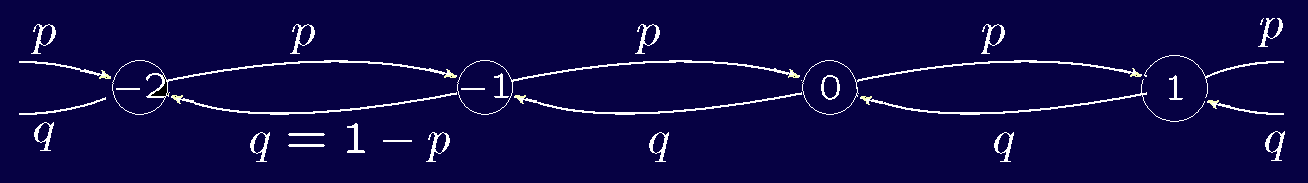

Simple Radom Walk
Random walk (RW) {S_{n}; n ≥ 1} is simple if X_{n} is binary with p_{X}(1) = p, p_{X}(-1) = q =1−p. This is just a scaling variation on a Bernoulli process.
Probability of X_{i} =1 for m out of n trials:
Pr{S_{n} =2m − n} = p^{m}q^{n−m} $\frac{\text{n}\text{!}}{\text{m}\text{!(}\text{m}\text{-}\text{n}\text{)! }}$
Pr$\left\{\bigcup_{\text{n}\text{=1}}^{\text{∞}}{\text{\{}\text{S}\text{n}\text{ ≥ }\text{k}\text{\}}}\right\}$=${\left(\frac{p}{q}\right)}^{k}$ if p ≤ 1/2

Slide 5
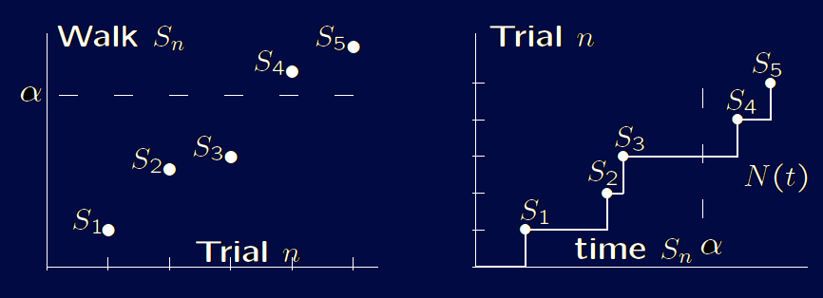
Simple Radom Walk
Integer RW (X_{i} is integer) can be modeled as a MC. Might have overshoot when crossing a threshold, analysis will be much harder.
Renewal processes are also special RW where X_{i} is a positive. When sketching sample paths, the axes are usually reversed from RP to RW.

Slide 6
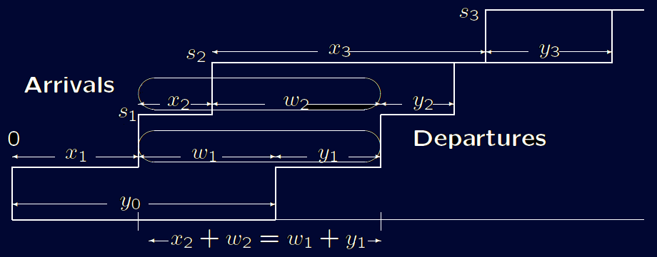
Queueing delay in a G/G/1 queue
Let {X_{i}; i ≥ 1} be the iid intervals of a G/G/1 queue, {Y_{i}; i ≥ 1} be the iid service requirements.
If arrival n see empty queue, w_{n} = 0 ; if it is queued,
x_{n} +w_{n} = w_{n−1} +y_{n−1} ∴ w_{n} = w_{n−1} +y_{n−1} - x_{n} if y_{n−1} + w_{n−1} ≥ x_{n}
This is true for all ample path，so W_{n} = max(W_{n−1} +Y_{n−1} – X_{n} , 0)
or W_{n} = max( W_{n−1} + U_{n} , 0) where U_{n} =Y_{n−1} – X_{n} .
{W_{n}; n ≥ 1} is a RW based on
{U_{n}; n ≥ 1} without max.
With the max, it looks like
a RW, reset to 0 whenever
goes negative

Slide 7
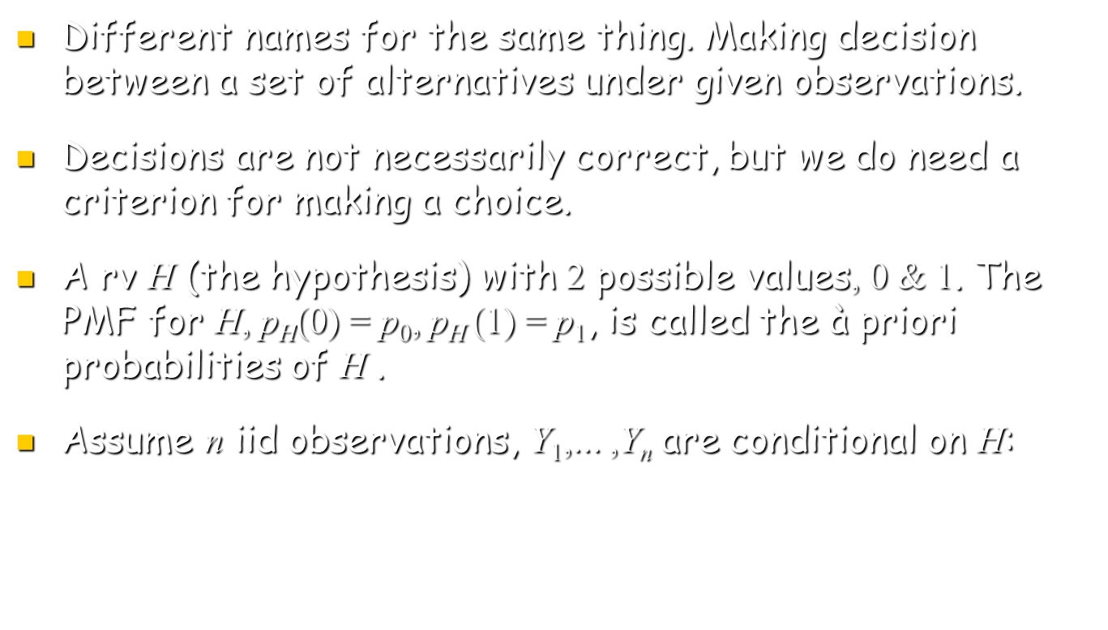
Detection, decisions, & Hypothesis Testing
Different names for the same thing. Making decision between a set of alternatives under given observations.
Decisions are not necessarily correct, but we do need a criterion for making a choice.
A rv H (the hypothesis) with 2 possible values, 0 & 1. The PMF for H, p_{H}(0) = p₀, p_{H} (1) = p₁, is called the à priori probabilities of H .
Assume n iid observations, Y₁,... ,Y_{n} are conditional on H:
p_{Y |H}( y | l ) = $\prod_{\text{i}\text{=1}}^{n}{\text{p}\text{Y}\text{i} \text{|}\text{H}\text{( }\text{y}\text{i} \text{| }\text{l} \text{)}}$ l = 0,1

Slide 8
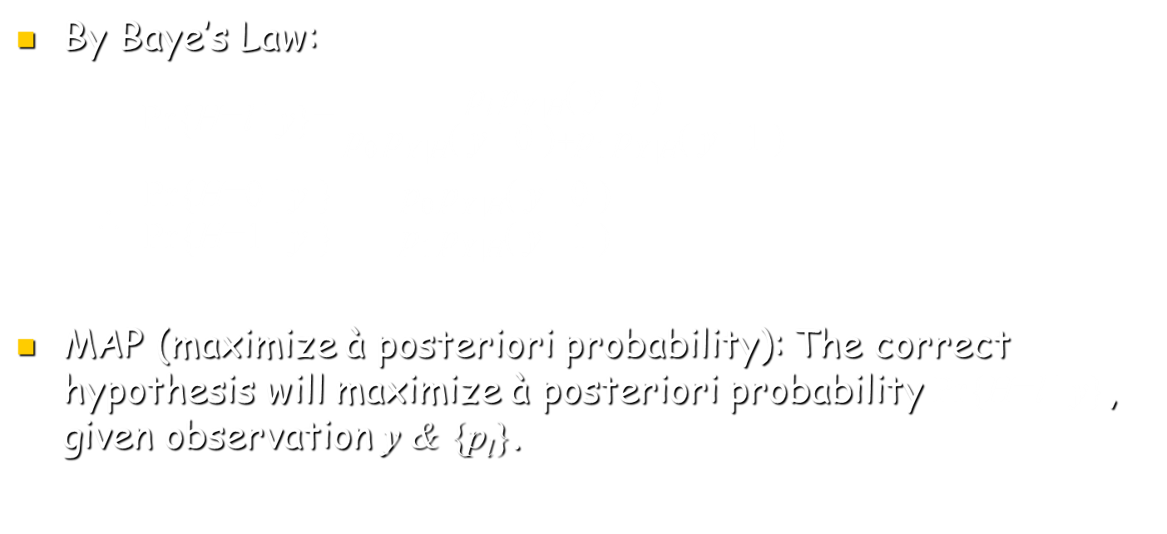
Detection, decisions, & Hypothesis Testing
By Baye’s Law:
Pr{H=l | y}= $\frac{\text{p}\text{l} \text{p}\text{Y} \text{|}\text{H}\text{( }\text{y} \text{| }\text{l} \text{)}}{\text{p}\text{0} \text{p}\text{Y} \text{|}\text{H}\text{( }\text{y} \text{| }\text{0} \text{)}+\text{p}\text{1} \text{p}\text{Y} \text{|}\text{H}\text{( }\text{y} \text{| }\text{1} \text{)}}$
∴ $\frac{ \text{Pr}\text{\{}\text{H}\text{=}\text{0} \text{| }\text{y} \text{\}} }{ \text{Pr}\text{\{}\text{H}\text{=}\text{1} \text{| }\text{y}\text{ \}} }$ = $\frac{ \text{p}\text{0} \text{p}\text{Y} \text{|}\text{H}\text{( }\text{y} \text{| }\text{0} \text{)} }{ \text{p}\text{1} \text{p}\text{Y} \text{|}\text{H}\text{( }\text{y} \text{| }\text{1} \text{)} }$
MAP (maximize à posteriori probability): The correct hypothesis will maximize à posteriori probability Pr{H=l | y}, given observation y & {p_{l}}.

Slide 9
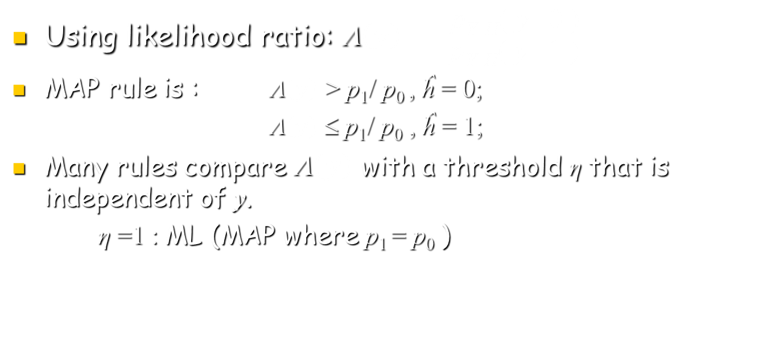
Detection, decisions, & Hypothesis Testing
Using likelihood ratio: Λ$\left(y\right)=\frac{ \text{p}\text{Y} \text{|}\text{H}\text{( }\text{y} \text{| 0} \text{) }}{ \text{p}\text{Y} \text{|}\text{H}\text{( }\text{y} \text{| 1} \text{)} }$
MAP rule is : Λ$\left(y\right)$ > p₁/ p₀ , ĥ = 0;
Λ$\left(y\right)$≤ p₁/ p₀ , ĥ = 1;
Many rules compare Λ$\left(y\right)$ with a threshold η that is independent of y.
η =1 : ML (MAP where p₁ = p₀ )

Slide 10
Detection, decisions, & Hypothesis Testing
Using likelihood ratio: Λ$\left(y\right)=\frac{ \text{p}\text{Y} \text{|}\text{H}\text{( }\text{y} \text{| 0} \text{) }}{ \text{p}\text{Y} \text{|}\text{H}\text{( }\text{y} \text{| 1} \text{)} }$
MAP rule is : Λ$\left(y\right)$ > p₁/ p₀ , ĥ = 0;
Λ$\left(y\right)$≤ p₁/ p₀ , ĥ = 1;
Many rules compare Λ$\left(y\right)$ with a threshold η that is independent of y.
η =1 : ML (MAP where p₁ = p₀ )

