Slide 1

Discrete Stochastic Processes
Lecture 05
________________________________________________________________________________________
2020 Autumn @ SDUWH

Slide 2
Renewal Process
Arrival vs renewal
Convergence WP1 and the SLLN
SLLN vs WLLN
Central limit theorem (CLT) for Renewals
Time average residual life
Stopping trials for stochastic processes
Wald’s equality
Stop when you’re ahead

Slide 3
Arrival vs Renewal
Arrival epochs {S₁,S₂,...} or arrival intervals {X₁,X₂,...} or counting {A(t); t>0} defines Arrival Process.
Renewal process is an arrival process for which the intervals {X₁,X₂,...} are IID.
Renewal processes ‘start over’ at each renewal. Intuitively, complex processes can be broken into discrete time intervals.
Renewal theory watch mainly
how many intervals occur per unit
time, laws of large numbers about
long term behavior, etc.
A(t)
X₃
X₂
A(τ)
X₁
s₁ s₂ τ s₃ t
Notes:
Nonevent sample is weird, usually ignorable.
The last is ho-hum but useful for limits.

Slide 4
Arrival vs Renewal
Eg: Markov chains, for any given recurrent state, have renewals on successive visits to that state. Intervals between visits to a given recurrent state are independent.
  The expected recurrence time between visits to state i is π_{i} , which is clearer using renewals than Markov chain.
  The whole theory for Markov chains with a countably infinite state space will come from renewal processes.
Notes:
Nonevent sample is weird, usually ignorable.
The last is ho-hum but useful for limits.

Slide 5
Arrival vs Renewal
Eg. G/G/M queue model (AD/SD/SN)
  Distribution types: M: exponential IID; D: Deterministic IID;
  Ek: Erlang with shape k; G: General IID.
  Queue is empty at t < 0, first arrival is at t = 0, queue length increases & decreases until empties out.
  When busy period comes, the queue life is renewed.

Slide 6
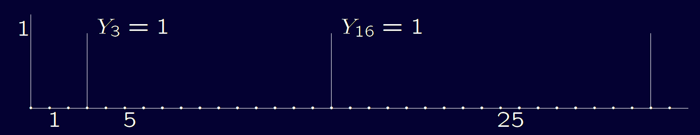
Convergence WP1 and the SLLN
Theorem: If rvs {Y_{n}; n ≥1} satisfy Σ_{n}E[ |Y_{n}| ] < ,
then lim _{n→} {Y_{n}; n ≥1} = 0 WP1,
or Pr{ω∈Ω : lim _{n→} Y_{n}(ω) = 0} = 1
Eg. Given {Y_{n}; n ≥1}, for each j >0 , Y_{n}=1 for equiprobable choice of n∈[5^{j},5^{j+1}), and Y_{n}=0 otherwise. Thus Y_{n} (ω) does not converge for any ω ; or {Y_{n}; n ≥1} doesn’t converge WP1.
From equiprobable distribution, E[ |Y_{n}| ] = 1/(5^{j+1} - 5^{j}), thus
Σ_{n} E[ |Y_{n}| ] = . But lim _{n→} Pr{|Y_{n}| >ε} = 0 , so {Y_{n}; n ≥1} converge
in a probability  1.

Slide 7
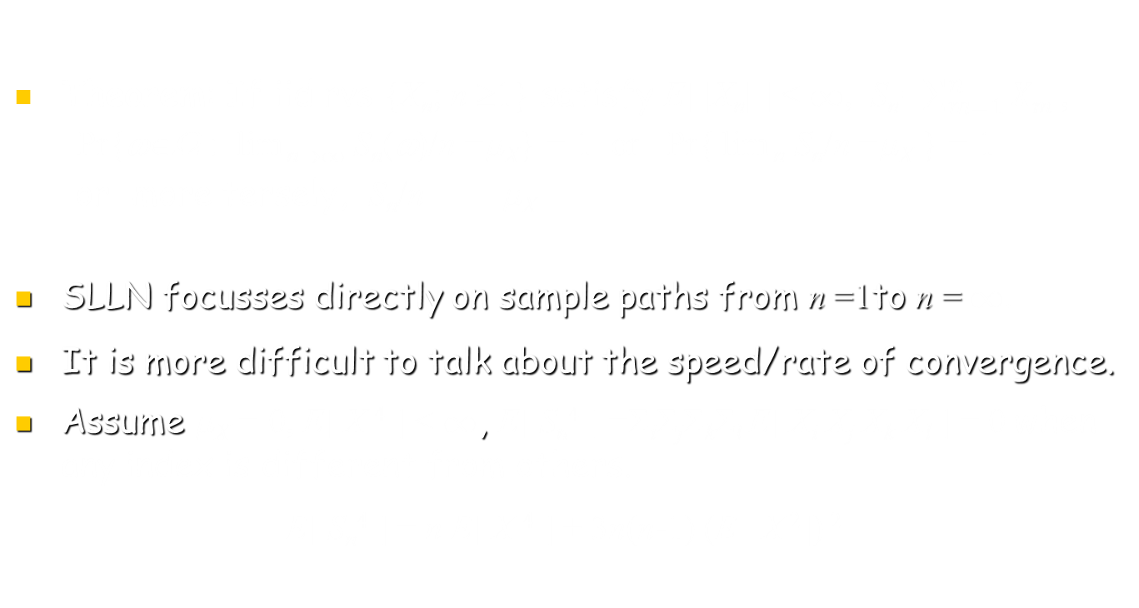
SLLN vs WLLN
Theorem: If iid rvs {X_{n}; n ≥1} satisfy E[ |X_{n}| ] < , S_{n}=$\sum_{m=1}^{n}{Xm}$ ,
Pr{ω∈Ω : lim _{n→} S_{n}(ω)/n =_{X}} = 1 or Pr{ lim _{n} S_{n}/n =_{X} } = 1
or more tersely, S_{n}/n _{X}
SLLN focusses directly on sample paths from n =1to n = .
It is more difficult to talk about the speed/rate of convergence.
Assume _{X} = 0, E[ X ⁴ ] < , E[ S_{n}⁴ ] =Σ_{i}Σ_{j}Σ_{k}Σ_{l} E[ X_{i} X_{j} X_{k} X_{l} ] = 0 when any index is different from others.
E[ S_{n}⁴ ] = n E[ X ⁴ ] + 3n(n-1) (E [ X ²]) ²

Slide 8
SLLN vs WLLN
Since E[X ⁴] is the 2nd moment of X ² , (E [X ²]) ² ≤ n E[X ⁴] ,
E[ S_{n}⁴ ] ≤ [n + 3n(n-1)] E[X ⁴] ≤ 3n² E[X ⁴] , thus
Σ_{n} (E[ S_{n}⁴ ] /n⁴) ≤ 3 E[X ⁴] Σ_{n} (1 /n²) < , ie.
Pr{ω∈Ω : lim _{n→} S_{n}⁴(ω)/n⁴ =0} = 1, thus
Pr{ lim _{n} S_{n}/n = 0 } = 1

Slide 9
SLLN vs WLLN
Eg. A Bernoulli process with p_{X}(1)=q. Then E[ X ] = q and, according to the above theorem, the sample path set Pr{ω: lim _{n} S_{n}/n = q} = 1.
Consider the other Bernoulli process with p_{X} (1)=q’ q, then Pr{ω: lim _{n} S_{n}/n = q’} = 1, while Pr{ω: lim _{n} S_{n}/n = q} = 0.
There are uncountably many choices for q, so there are uncountable events, each of probability 1 for its own q.
This partitions the sample space into an uncountable collection of events, each with probability 1 for its own q, plus events with no convergence.
There is nothing wrong here, events are peculiar.

Slide 10

SLLN vs WLLN
Theorem: If rvs {Y_{n}; n ≥1} satisfy $\sum_{n=1}^{∞}{\text{E}}$[ |Y_{n}| ] < ,
Pr{ω∈Ω : lim _{n→} Y_{n}(ω) = 0} = 1 .
$\sum_{n=1}^{∞}{\text{E}}$[ |Y_{n}| ] <  means that lim _{n→} $\sum_{n=1}^{∞}{\text{E}}$[ |Y_{n}| ] = 0, which is much stronger than lim _{n→} E[ |Y_{n}| ] = 0.
Usefulness of this theorem depends on choice of Y₁,Y₂, ...
In general, {Z_{n}; n ≥1} converges to a constant α WP1 means Pr{ω∈Ω : lim _{n→} Y_{n}(ω) = α } = 1 .
  {Z_{n}; n ≥1} converges to α iff {Z_{n}- α; n ≥1} converges to 0.
  {X_{n}; n ≥1} is iid with _{X} = α , then {X_{n}- α; n ≥1} is iid with mean 0.

Slide 11
SLLN for Renewal Processes
Theorem: Assume {Z_{n}; n ≥1} converge to α WP1, & real value f (x) is continuous at x = α, then {f (Z_{n}); n ≥1} converge to f (α) WP1.
Eg. If f (x) = x+β for constant β, and Z_{n} converges to α, then U_{n} = Z_{n} + β converges to α+β.
Eg. If f (x) = x^{1/4} for x≥0, & Z_{n} ≥0 converges to 0 WP1, then f (Z_{n}) converges to f (0).

Slide 12
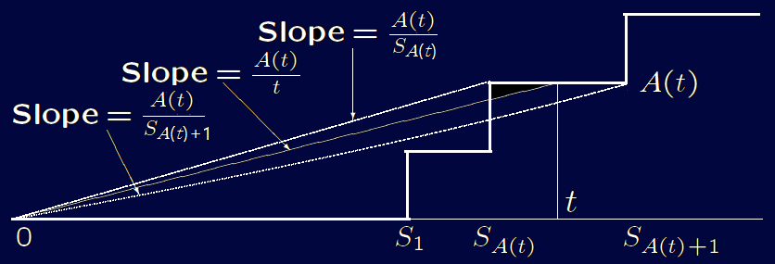
SLLN for Renewal Processes
Theorem: If lim_{n}Z_{n} = α WP1, & f (x) is continuous at x = α, then lim_{n} f (Z_{n}) = f (α) WP1.
For renewal process, each inter-renewal interval X_{i} is positive and E[ X ] >0, then E[ S_{n}/n ] >0. Thus SLLN applies
Pr{ω: lim _{n→} S_{n}(ω)/n =_{X}} = 1
Using f (x) =1/x , Pr{ω: lim _{n→} n/S_{n}(ω) =1/_{X}} = 1
Theorem: For a renewal process with _{X} < ∞,
Pr{ω: lim _{t→} A(t)/t =1/_{X}} = 1
A(t)/S_{A(t)} & n/S_{n} go through
the same set of values.

Slide 13
SLLN for Renewal Processes
A(t)/S_{A(t)} & n/S_{n} go through the same set of values,
lim _{t→} A(t)/S_{A(t)} = lim _{n→} n/S_{n} = 1/_{X} WP1.
Note A(t)/S_{A(t)+1} & n/S_{n+1} also go through the same set of values,
lim _{t→} A(t)/S_{A(t)+1} = lim _{n→} n/S_{n+1}
= lim _{n→} (n+1)/S_{n+1} × n/(n+1)
=1/_{X} WP1.
Since A(t)/t is between A(t)/S_{A(t)} and A(t)/S_{A(t)+1} with the same limit,
lim _{t→} A(t)/t = 1/_{X} WP1.

Slide 14
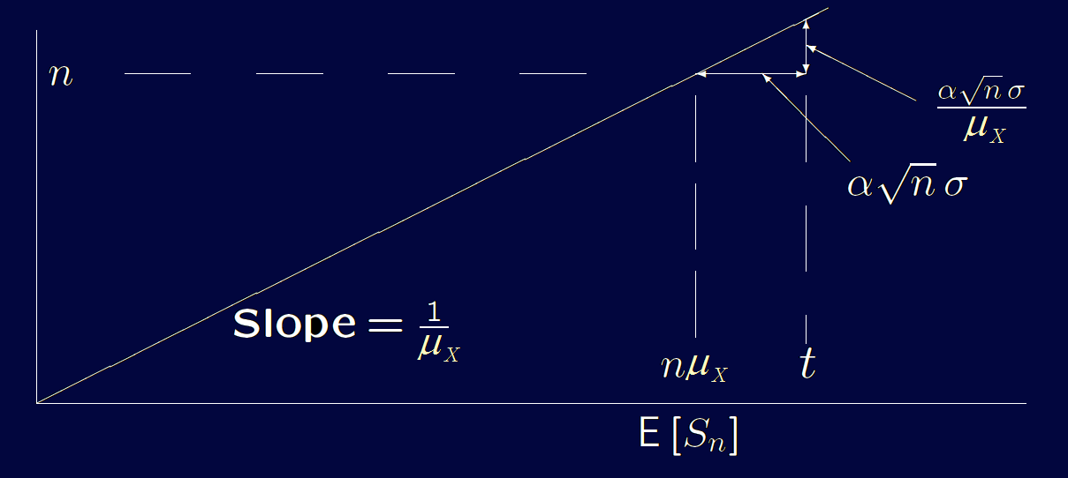

Central limit theorem (CLT) for Renewals
Pr{S_{n}< t } ≈ Φ (α); t = nμ_{X} + ασ n^{0.5}
Pr{A(t) ≥ n } ≈ Φ (α); n ≈ t /μ_{X} - ασ t^{0.5}/μ_{X}^{1.5}
ie. Pr{A(t) ≥ t /μ_{X} - ασ t^{0.5}/μ_{X}^{1.5} } ≈ Φ (α), Pr{$\frac{\text{A}\text{(}\text{t}\text{) - }\text{t} \text{/}\text{m}\text{X}}{\text{s} \text{t}\text{0.5}\text{/}\text{m}\text{X}\text{1.5}}$ ≥ - α} ≈ Φ (α);
so Pr{$\frac{\text{A}\text{(}\text{t}\text{) − }\text{t} \text{/}\text{m}\text{X}}{\text{s} \text{t}\text{0.5}\text{/}\text{m}\text{X}\text{1.5}}$ ≤ - α } ≈ 1- Φ (α) = Φ (-α) ;
A(t) ~ N($\text{m}\text{A}$, $\text{s}\text{A}$),
$\text{m}\text{A}$ = t /μ_{X}
$\text{s}\text{A}$ = $\text{s} \text{t}\text{0.5}\text{/}\text{m}\text{X}\text{1.5}$

Slide 15
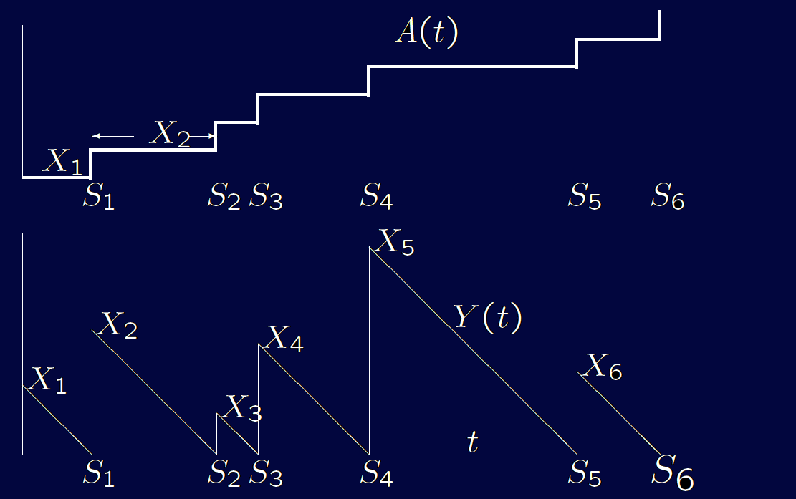
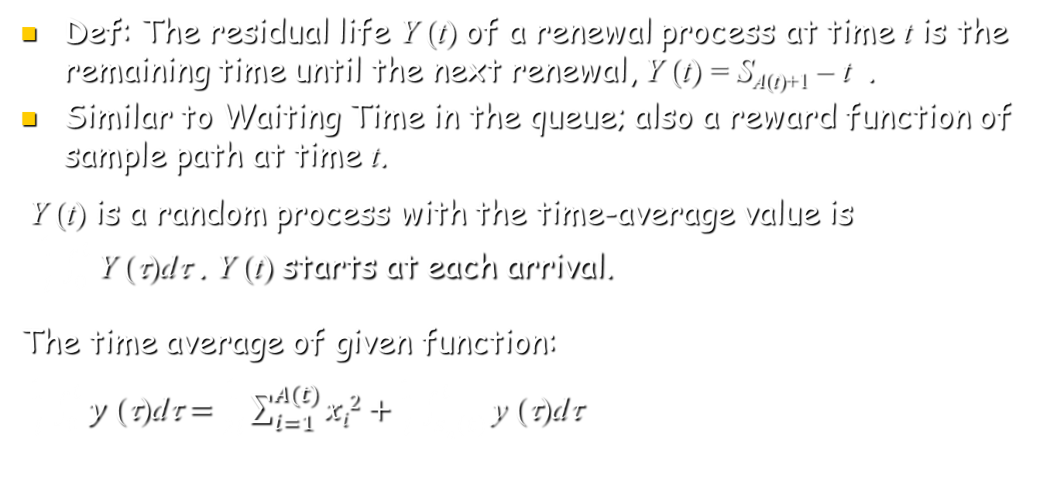
Time-average Residual Life
Def: The residual life Y (t) of a renewal process at time t is the remaining time until the next renewal, Y (t) = S_{A(t)+1} – t .
Similar to Waiting Time in the queue; also a reward function of sample path at time t.
Y (t) is a random process with the time-average value is
$\frac{\text{1}}{\text{t}}\int_{0}^{t}{\text{Y}\text{ (}\text{t}\text{)}\text{d}\text{t}}$ . Y (t) starts at each arrival.
The time average of given function:
$\frac{\text{1}}{\text{t}}\int_{0}^{t}{y\text{ (}\text{t}\text{)}\text{d}\text{t}}=\frac{\text{1}}{2\text{t}}\sum_{i=1}^{A(t)}{xi2}+\frac{\text{1}}{\text{t}}\int_{sn(t)}^{t}{\text{y}\text{ (}\text{t}\text{)}\text{d}\text{t}}$

Slide 16

Jordan form
$\frac{\text{1}}{2\text{t}}\sum_{i=1}^{A(t)}{Xi2}≤\frac{\text{1}}{\text{t}}\int_{0}^{t}{Y\text{ (}\text{t}\text{)}\text{d}\text{t}}≤\frac{\text{1}}{2\text{t}}\sum_{i=1}^{A\left(t\right)+1}{Xi2}$
lim _{t→} $\frac{\text{1}}{2\text{t}}\sum_{i=1}^{A(t)}{Xi2}$ = lim _{t→}$\frac{\sum_{i=1}^{A(t)}{Xi2}}{A(t)}\frac{A(t)}{2\text{t}}$ =$\frac{E[X2]}{2E[X]}$ WP1.
Y_{TA} = lim _{t→}$\frac{\int_{0}^{t}{Y\text{ (}\text{t}\text{)}\text{d}\text{t}}}{t}$ =$\frac{E[X2]}{2E[X]}$ WP1.

Slide 17
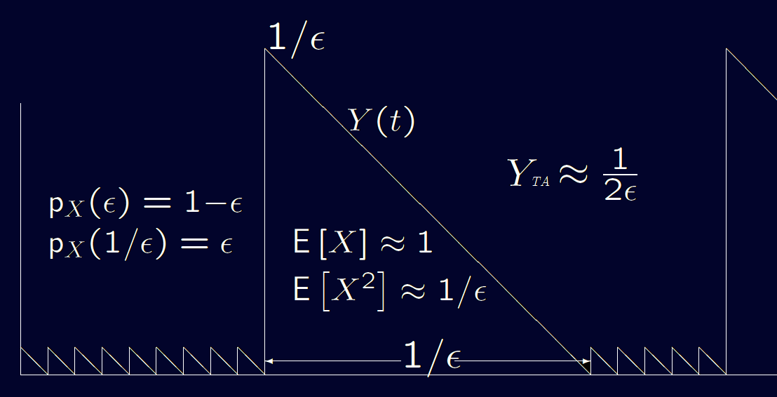

Rewards for Markov Chains
  When X is deterministic Y_{TA} = $E[X$]/2;
  When X is exponential Y_{TA} = $E[X$];
  The expected duration
  between long
  intervals is ≈ 1.

Slide 18
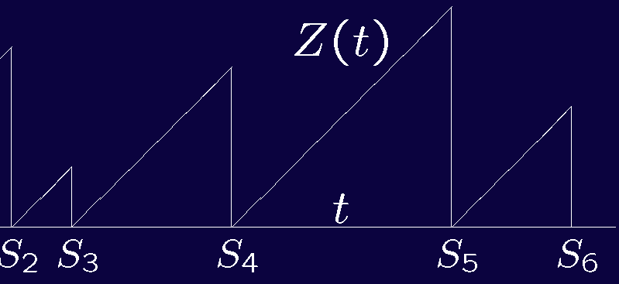
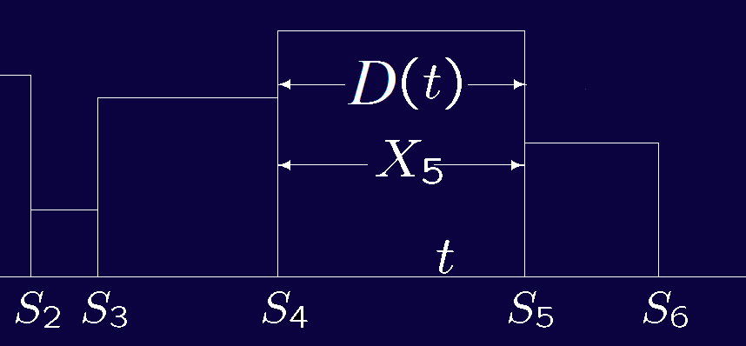

Time-average Residual life
More Example:
Age: Z(t)=t-S_{A(t)} ； Duration: D(t)=S_{A(t)+1} - S_{A(t)}
$\lim_{t→∞}{\frac{1}{t}\int_{0}^{t}{Z(τ)}}dτ= \frac{E[X^{2}]}{2E[X]}$ WP1; $\lim_{t→∞}{\frac{1}{t}\int_{0}^{t}{D(τ)}}dτ= \frac{E[X^{2}]}{E[X]}$ WP1

Slide 19
Time-averages for renewal rewards
Residual life, age, and duration are examples of rewards of renewal processes. The reward R(t) is restricted to be a function of the inter-renewal period containing t. In simplest form, is a function R(Z(t), X(t)).
The time-averaged R(t) of sample path is the analog to residual life starting with the n^{th} inter-renewal interval.
R₁(ω) = 0 with Z(t) = t ; For R_{n}(ω) , Z(t) = t – S_{n-1};

Slide 20
Time-averages for renewal rewards
R_{n} is a function of X_{n}
Thus

Slide 21
Time-averages for renewal rewards
Eg. Find the k^{th} moment of the Age process,
r[Z (t),D (t)] = Z^{k}(t)

Slide 22
Stopping trials for stochastic processes
Range (0,t] is important to initial segment. Since t becomes a rv which is a function of {X(t); τ ≤ t}, we have to be careful. Now consider only discrete-time processes {X_{i}; i ≥ 1}.
Let J be a positive integer rv describing the time when {X_{i}; i ≥ 1} is stopped.
  At trial 1, observe X₁(ω) then make a decision that whether to stop or not. If we stop, J(ω)=1;
  At trial 2 (if J(ω)1 ), observe X₂(ω) then make a decision.
  If stop, J(ω)=2;
  At trial 3 (if J(ω)1, 2 ), observe X₃(ω) then make a. If stop, J(ω)=3; …
  At each trial n (if no stopping occurs), X_{n}(ω ) is observed,
  if stop, J(ω)=n.

Slide 23
Stopping trials for stochastic processes
Def: A stopping trial J for {X_{n}; n ≥1}, is a positive integer rv such that for each n ≥ 1, the indicator I_{{J=n}} is function of{X₁,X₂,... ,X_{n}}.
Now visualize ‘conducting’ successive trials on X₁,X₂,...} until some n at which the event {J = n} occurs. It is simpler to keep observing trials after the stopping trial.
Since J is a (possibly defective) rv, the events {J = 1}, {J =2},... are disjoint.
Examples: Gambler gambles until broke; Flipping until 10 heads successively appear; Observe successive renewals until S_{n} ≥ 100.

Slide 24
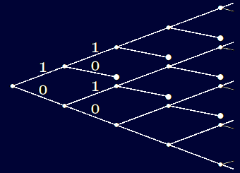
Stopping trials for stochastic processes
Suppose the rv’s X_{i} in a process {X_{n}; n ≥1} have a finite number of possible sample values. Then any (possibly defective) stopping trial J can be represented as a rooted tree where the trial at which each sample path stops is represented by a terminal node.
Eg. X is binary and stopping
occurs when the pattern
(1, 0) first occurs.

Slide 25
Wald’s equality
Theorem: Let {X_{n}; n ≥1} be a sequence of IID rv’s, each of mean _{X}. If J is a stopping trial & E[J ] < ∞, then the sum S_{J} = X₁+ X₂+ ··· + X_{J} at the stopping trial J satisfies
E[S_{J}] = _{X} E[J ]
Proof: S_{J} = X₁I_{J ≥1} + X₂I_{J ≥2}+···+X_{n}I_{J ≥n}+···
E[S_{J} ]= E[_{n}X_{n}I_{J ≥n}] = _{n}E[X_{n}I_{J ≥n}]
Essence of the proof is to show: X_{n} and I_{J ≥n} are independent. Since I_{J ≥n} = 1- I_{J <n} , I_{J <n} is also a function of X₁, ... , X_{n-1}. Now {X_{n}} are IID, X_{n} is independent of of X₁, ... , X_{n-1} , I_{J <n} , I_{J ≥n} .
But X_{n} is certainly not independent of I_{J =n} nor I_{J =n+1}, etc.

Slide 26
Wald’s equality
Given that J ≥ n (i.e., that stopping has not occurred before trial n), the trial at which stopping occurs depends on X_{n} , but whether or not J ≥ n occurs depends only on X₁, ... , X_{n-1}.
E[S_{J} ] = _{n}E[X_{n}I_{J ≥n}] = _{n}E[X_{n}]E[I_{J ≥n}]
= _{X} _{n}E[I_{J ≥n}] = _{X} _{n}Pr{I_{J ≥n}} = _{X} E[J ] ##
In many applications, this gives us one equation in two quantities neither of which is known. Frequently, E[S_{J} ] is easy to find and this solves for E[J ].

Slide 27
Stop when you’re ahead
Consider tossing a coin with head probability of q. $1 is bet on each toss and you win on heads, lose on tails. You stop when your winnings reach $1.
If q > 1/2, your winnings (WITHOUT stopping) would grow without bound, so J must be a rv where S_{J} =1 WP1, so E[S_{J}]=1. Thus, E[J ] = 1/_{X}=1/(2q-1) .
Note that J =1 with probability q. If J > 1, i.e., if S₁= −1, then the only way to reach S_{n} =1 is to go from S₁= −1 to S_{m}=0 for some m (requiring _{J} steps on average); _{J} more steps on average then gets to 1.
Thus _{J} = 1+2(1 − q)_{J} ,  _{J} =1/(2q-1)

Slide 28
Stop when you’re ahead
Next consider q < 1/2. It is still possible to win and stop (eg, J =1 with probability q and J =3 with probability 2q(1−q)).
Let θ = Pr{J<}，Pr{J =1} = q. Given that J > 1, i.e., that S₁=−1, the event {J<}requires that S_{m} − S₁=1 for some m, and then Sn − S_{m} =1 for some n>m. These are independent events of probability θ, so θ = q+(1 − q) θ ²
There are two solutions, θ = q/(1 − q ) and θ = 1, which is impossible. Thus J is defective and Wald’s equation is inapplicable.

Slide 29
Stop when you’re ahead
Finally consider q =1/2. In the limit as q approaches 1/2 from below, Pr{J< ∞} =1. However, as q approaches 1/2 from above, E [J ]= ∞.
Wald’s equality does not hold, and in fact does not make sense since _{X} =0. However, you make your $1 WP1 in a fair game and can continue to repeat the same feat.
It takes an infinite time, and requires access to an infinite capital.

