Slide 1

Discrete Stochastic Processes
Lecture 04
________________________________________________________________________________________
2020 Autumn @ SDUWH

Slide 2
Markov eigenvalue & eigenvector
Review of ergodic unichains
Basic algebra facts
Markov chains with 2 states
Distinct eigenvalues for M >2 states
M states & M independent eigenvectors
Rewards for Markov chains
Expected first-passage-times
Aggregate rewards with a final reward
Dynamic programming

Slide 3
Review of Ergodic Unichains
For an ergodic finite-state Markov chain, the transition probabilities reach a limit:
lim_{n→∞}P_{ij;n} =π_{j}  i
π ={π_{j} : j=1, 2, 3,…} is strictly positive row vector.
Multiplying both sides by P_{jk} and summing over j,
lim_{n→∞}_{j}P_{jk} P_{ij;n} =_{j}P_{jk}π_{j} = π_{k}
thus π is a steady-state vector with π P =π , P =e^{T}π .
Notes:
Nonevent sample is weird, usually ignorable.
The last is ho-hum but useful for limits.

Slide 4

Review of Ergodic Unichains
Same result almost holds for ergodic unichains. The only difference is that the steady-state vector is positive for all ergodic states and 0 for all transient states.
$P=\left[\begin{matrix}PT & PTR \\ 0 & PR\end{matrix}\right]$ where $PT=\left[\begin{matrix}P11 & ⋯ & P1M \\ ⋮ & ⋱ & ⋮ \\ PM1 & ⋯ & PMM\end{matrix}\right]$
Each transient state eventually transits (via $PTR$ ) to a recurrent state, and recurrent states lead to steady state as before.

Slide 5
Basic Linear Algebra Facts
Def: Complex number λ is an eigenvalue of real square matrix A, and complex vector v  0 is a right eigenvector of A, if λv =Αv.
  For every stochastic transition matrix of a finite-state Markov chain, P, we have _{j}P_{ij} =1, thus Pe = e , ie. λ =1 is an eigenvalue of an arbitrary stochastic matrix P with right eigenvector e. An equivalent way is: (P −λI ) v =0 , where I is the identity matrix.
Def: Square matrix A is singular if there is a vector v  0 that gives Αv=0.Thus λ is an eigenvalue of P iff (P −λI ) is singular for some v=0.
  Let a₁,... ,a_{M} be the columns of A. Then A is singular iff a₁,... ,a_{M} are linearly dependent. The square matrix A is singular iff its row vectors are linearly dependent, or iff the determinant det A =0.

Slide 6
Basic Linear Algebra Facts
Summary: λ is an eigenvalue of P
iff (P −λI ) is singular,
iff det (P −λI )=0,
iff Pv = λv for some v  0.
For any stochastic matrix P, if Pe = e, thus (P −λI ) is singular and there is a row vector π  0 such that π P = π .
We have already seen such a probability vector π (steady-state vector) if P is the matrix of an ergodic unichain. There is a steady-state vector π for all Markov chains.

Slide 7
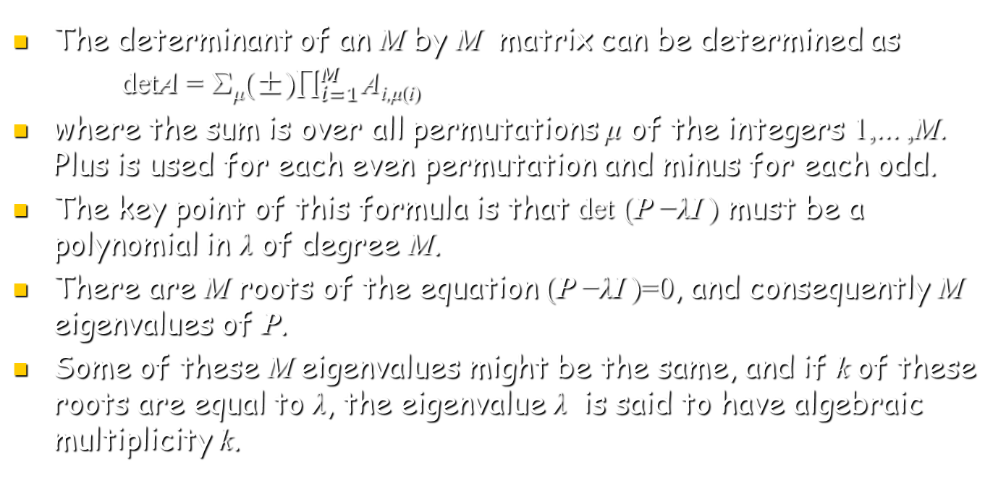
Basic Linear Algebra Facts
The determinant of an M by M matrix can be determined as
detA = (±)$\prod_{i=1}^{M}{\text{A}\text{i}\text{,}\text{μ}\text{(}\text{i}\text{)}}$
where the sum is over all permutations μ of the integers 1,... ,M. Plus is used for each even permutation and minus for each odd.
The key point of this formula is that det (P −λI ) must be a polynomial in λ of degree M.
There are M roots of the equation (P −λI )=0, and consequently M eigenvalues of P.
Some of these M eigenvalues might be the same, and if k of these roots are equal to λ, the eigenvalue λ is said to have algebraic multiplicity k.

Slide 8
Markov Chain of 2 states
  π₍₁₎P₁₁ + π ₍₂₎ P₂₁ = λ π ₍₁₎ P₁₁ν ₍₁₎ + P₁₂ ν ₍₂₎ = λ ν₍₁₎
  π₍₁₎P₁₂ + π ₍₂₎ P₂₂ = λ π ₍₂₎ P₂₁ν ₍₁₎ + P₂₂ ν ₍₂₎ = λ ν₍₂₎
  left eigenvector right eigenvector
  det(P − λI)=(P₁₁ − λ)(P₂₂ − λ) − P₁₂ P₂₁
λ₁ =1; λ₂=1 − P₁₂ − P₂₁
If P₁₂ = P₂₁ = 0 (the chain has 2 recurrent classes), then λ₁ =1 has multiplicity 2 .
If P₁₂ = P₂₁ = 1 (the chain is periodic), then λ₂= -1 Otherwise | λ₂|<1.

Slide 9

Markov Chain of 2 states
  π₍₁₎P₁₁ + π ₍₂₎ P₂₁ = λ π ₍₁₎ P₁₁ν ₍₁₎ + P₁₂ ν ₍₂₎ = λ ν₍₁₎
  π₍₁₎P₁₂ + π ₍₂₎ P₂₂ = λ π ₍₂₎ P₂₁ν ₍₁₎ + P₂₂ ν ₍₂₎ = λ ν₍₂₎
  λ₁ =1; λ₂=1 − P₁₂ − P₂₁
Assume throughout that either P₁₂ >0 or P₂₁ >0 , then
$\begin{matrix}\text{π}\text{1}\text{=}(\frac{\text{P}\text{21}}{\text{P}\text{1}\text{2}\text{+}\text{P}\text{21}},\frac{\text{P}\text{1}\text{2}}{\text{P}\text{12}\text{+}\text{P}\text{21}}) & \text{ν}\text{1} \text{=}\text{(1,1)}\text{T} \\ \text{π}\text{2}\text{=}\left(1,−1\right) & \text{ν}\text{2} \text{=(}\frac{\text{P}\text{12}}{\text{P}\text{12}\text{+}\text{P}\text{21}},\frac{\text{−}\text{P}\text{2}\text{1}}{\text{P}\text{12}\text{+}\text{P}\text{21}}\text{)}\text{T}\end{matrix}$
Note that π_{i}ν_{j} =δ_{ij} , in general, if π_{i}P = λ_{i} π_{i} , and Pv_{i} = λ_{i} v_{i} , for all the i=1,2,…,M, then π_{i} v_{j} = 0 if λ_{i}  λ_{j} .

Slide 10

Markov Chain of 2 states
Note that equations
P₁₁ v_{i(1)}+P₁₂ v_{i(2)}= λ_{i} v_{i(1)} , P₂₁ v_{i(1)}+P₂₂ v_{i(2)}= λ_{i} v_{i(2)}
can be rewritten as PU = UΛ , where
Λ=$\left[\begin{matrix}\text{l}1 & \text{0} \\ \text{0} & \text{l}\text{2}\end{matrix}\right]$, U=$\left[\begin{matrix}\text{v}\text{1}\text{(1)} & \text{v}\text{1}\text{(}\text{2}\text{)} \\ \text{v}\text{2}\text{(1)} & \text{v}\text{2}\text{(}\text{2}\text{)}\end{matrix}\right]$
Since π_{i}ν_{j} =δ_{ij} ,
$\left[\begin{matrix}\text{p}\text{1(1)} & \text{p}\text{1(2)} \\ \text{p}\text{2(1)} & \text{p}\text{2(2)}\end{matrix}\right]$ $\left[\begin{matrix}\text{v}\text{1(1)} & \text{v}\text{1(2)} \\ \text{v}\text{2(1)} & \text{v}\text{2(2)}\end{matrix}\right]$=I
This means U is invertible: P=UΛU⁻¹ , P²=UΛ²U⁻¹ … P^{n}=UΛ^{n}U⁻¹ ,
P^{n} =$\sum_{i=1}^{M}{\text{λ}\text{i}\text{n}\text{v}\text{i}\text{p}}\text{i}$

Slide 11
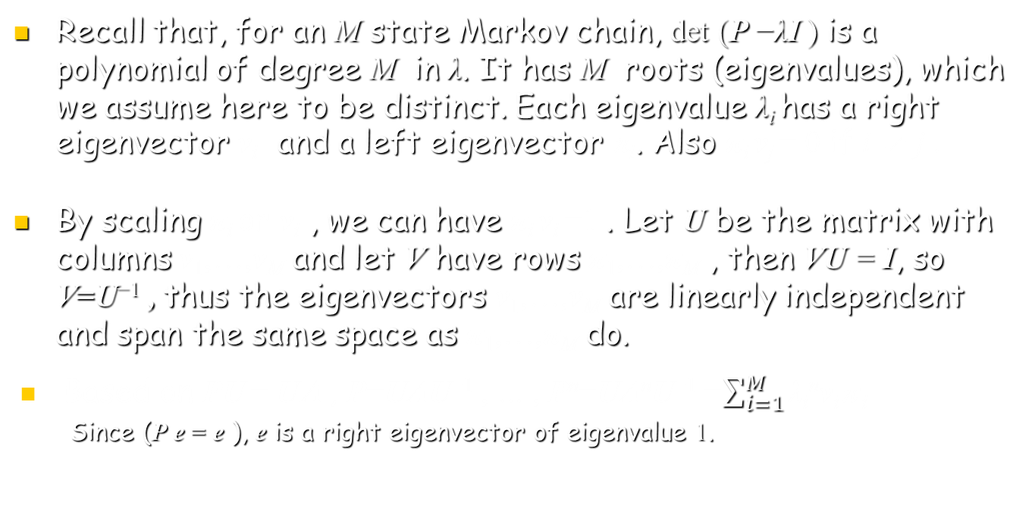
Distinct eigenvalues for M>2 states
Recall that, for an M state Markov chain, det (P −λI ) is a polynomial of degree M in λ. It has M roots (eigenvalues), which we assume here to be distinct. Each eigenvalue λ_{i} has a right eigenvector v_{i} and a left eigenvector $\text{p}\text{i}$. Also π_{i} v_{j} = 0 if i  j .
By scaling π_{i} or v_{i} , we can have π_{i} v_{i} =1 . Let U be the matrix with columns v₁,…,v_{M} and let V have rows π₁,…,π_{M} , then VU = I, so V=U⁻¹ , thus the eigenvectors v₁,…,v_{M} are linearly independent and span the same space as π₁,…,π_{M} do.
Based on PU = UΛ , P=UΛU⁻¹ , … , P^{n}=UΛ^{n}U⁻¹ =$\sum_{i=1}^{M}{\text{λ}\text{i}\text{n}\text{v}\text{i}\text{p}}\text{i}$
  Since (P e = e ), e is a right eigenvector of eigenvalue 1.

Slide 12
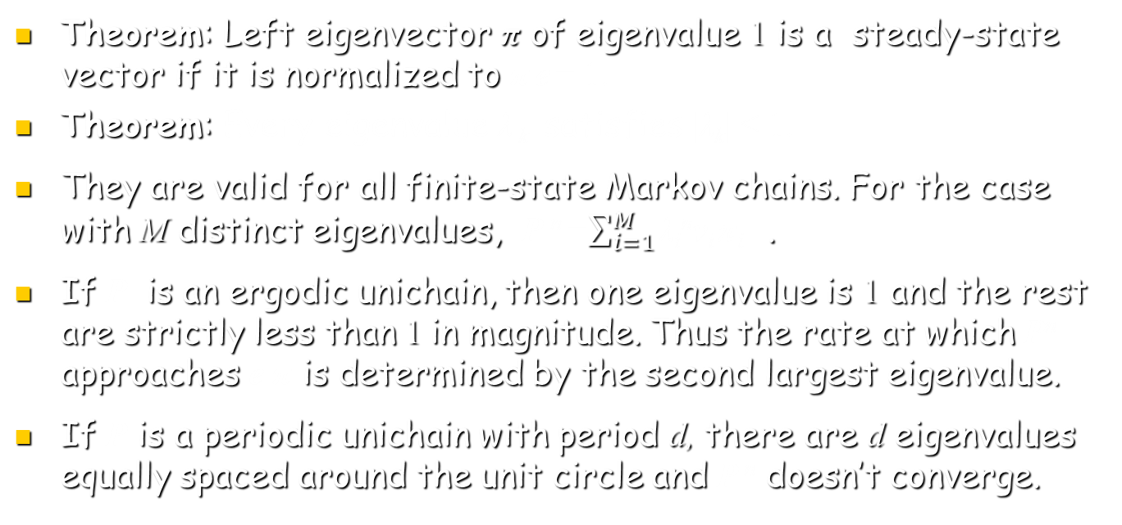
Distinct eigenvalues for M>2 states
Theorem: Left eigenvector π of eigenvalue 1 is a steady-state vector if it is normalized to π e = 1.
Theorem: Every eigenvalue λ _{k} satisfies |λ_{k}| ≤ 1.
They are valid for all finite-state Markov chains. For the case with M distinct eigenvalues, P ^{n} =$\sum_{i=1}^{M}{\text{λ}\text{i}\text{n}\text{v}\text{i}\text{p}}i$ .
If P is an ergodic unichain, then one eigenvalue is 1 and the rest are strictly less than 1 in magnitude. Thus the rate at which P^{n} approaches e π is determined by the second largest eigenvalue.
If P is a periodic unichain with period d, there are d eigenvalues equally spaced around the unit circle and P ^{n} doesn’t converge.

Slide 13
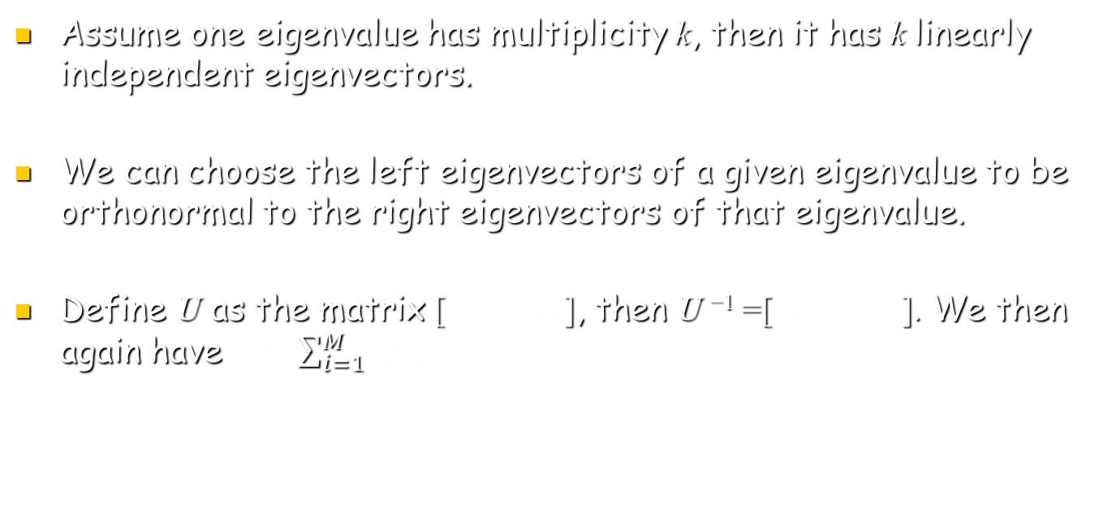
M states & M independent eigenvectors
Assume one eigenvalue has multiplicity k, then it has k linearly independent eigenvectors.
We can choose the left eigenvectors of a given eigenvalue to be orthonormal to the right eigenvectors of that eigenvalue.
Define U as the matrix [v₁,…,v_{M} ], then U ⁻¹ =[π₁;…;π_{M} ]. We then again have P ^{n} =$\sum_{i=1}^{M}{\text{λ}\text{i}\text{n}\text{v}\text{i}\text{p}}i$

Slide 14
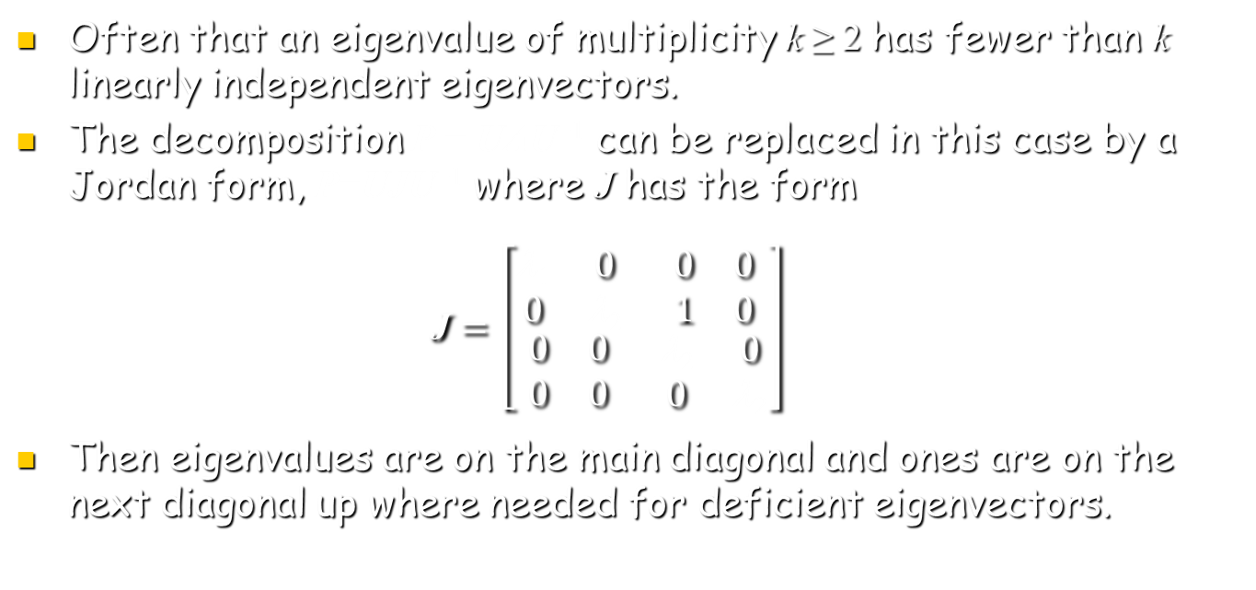
Jordan form
Often that an eigenvalue of multiplicity k ≥ 2 has fewer than k linearly independent eigenvectors.
The decomposition P = UΛU⁻¹ can be replaced in this case by a Jordan form, P=UJU⁻¹ where J has the form
$\text{J}=\left[\begin{matrix}\begin{matrix}\text{l}\text{1} & 0 \\ 0 & \text{l}\text{2}\end{matrix} & \begin{matrix}0 & 0 \\ 1 & 0\end{matrix} \\ \begin{matrix}0 & 0 \\ 0 & 0\end{matrix} & \begin{matrix}\text{l}\text{2} & 0 \\ 0 & \text{l}2\end{matrix}\end{matrix}\right]$
Then eigenvalues are on the main diagonal and ones are on the next diagonal up where needed for deficient eigenvectors.

Slide 15
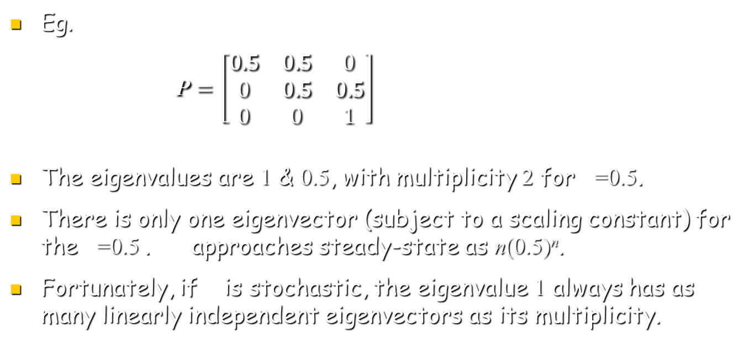
Jordan form
Eg.
$\text{P}=\left[\begin{matrix}\text{0.5} & \text{0.5} & 0 \\ 0 & \text{0.5} & \text{0.5} \\ 0 & 0 & 1\end{matrix}\right]$
The eigenvalues are 1 & 0.5, with multiplicity 2 for $\text{l}$=0.5.
There is only one eigenvector (subject to a scaling constant) for the $\text{l}$=0.5 . P ^{n} approaches steady-state as n(0.5)^{n}.
Fortunately, if P is stochastic, the eigenvalue 1 always has as many linearly independent eigenvectors as its multiplicity.

Slide 16

Rewards for Markov Chains
According to the definition of Determinant, when
$P=\left[\begin{matrix}PT & PTR \\ 0 & PR\end{matrix}\right]$ , detP = detP_{T} detP_{R} ,
det[P - $\text{l}$I ]= det [P_{T} - $\text{l}$I ] det [P_{R} - $\text{l}$I ]
Eigenvalues of P are the t eigenvalues of P_{T} and the r eigenvalues of P_{R} .
If π is a left eigenvector of P_{R}, then [0,...,0, π₁,..., π_{r}] is a left eigenvector of P, i.e.
$$\left[0,\text{π}\right]\left[\begin{matrix}PT & PTR \\ 0 & PR\end{matrix}\right]=\text{l}\left[0,\text{π}\right]$$

Slide 17

Rewards for Markov Chains
Assume $P=\left[\begin{matrix}P_{T} & P_{TR} & P_{TR′} \\ 0 & P_{R} & 0 \\ 0 & 0 & P_{R′}\end{matrix}\right]$ , so
det[P - $\text{l}$I ]= det [P_{T} - $\text{l}$I_{t} ] det [P_{R} - $\text{l}$I_{r}] det [P_{R} - $\text{l}$I_{r’}]
# of eigenvalues: t + r + r’ .
If π is a left eigenvector of P_{R} , then [0, π, 0] is a left eigenvector of P ;
If π is a left eigenvector of P_{R’} , then [0, 0, π] is a left eigenvector of P ;

Slide 18
M states & M independent eigenvectors
Suppose each state i of Markov chain is associated with a given reward, r_{i} .
Letting the X_{n} be the state at time n； random reward at time n is R(X_{n}) that maps X_{n} = i into ri for each state i.
The expected rewards at time n, given that X₀ = i is
E [R(X_{n})|X₀ = i] = Σ _{j} r_{j}P_{ij;n}
The expected aggregate reward over n steps from m to m+n − 1, conditional on X_{m} = i is then
v_{i}(n)= E [R(X_{n})+…+ R(X_{m+n-1})|X_{m} = i] = r_{i} + Σ _{j} r_{j}P_{ij} +…+Σ _{j} r_{j}P_{ij;n-1}

Slide 19
M states & M independent eigenvectors
v_{i}(n) = r_{i} + Σ _{j} r_{j}P_{ij} +…+Σ _{j} r_{j}P_{ij;n-1}
If Markov chain is an ergodic unichain, then successive terms of this expression end to a steady state Gain per step: g = Σ _{j} π_{j}r_{j} which is independent of starting state.
Thus v_{i}(n) can be viewed as a transient in state i plus ng , if g =0, v_{i}(n) is just only the Transient.

Slide 20
Expected First-passage-time
Suppose we want to find the expected number of steps of an arbitrary unichain, starting from a given state i1 until recurrent state, i =1, is first entered.
This can be viewed as a reward problem by assigning one unit of reward to each successive state, reward stops when state 1 is entered, P₁₁=1, r₁=0.
For each sample path starting from state i  1, the initial segment probability is unchanged until 1 is entered, so the expected first-passage-time is also unchanged.

Slide 21
Expected First-passage-time
The modified Markov chain is now an ergodic unichain with a single recurrent state, i.e., state 1 is a trapping state. Let r_{i}=1 ∀ i  1, r₁=0 , if state 1 is first entered at time l, the aggregate reward, from 0 to n, will be l for all n > l.
The expected first passage time, start from state i is :
v_{i}=lim_{n}v_{i}(n).
A sneaky way : For each state i  1, assume that X₀=i, r_{i}=1 at time n=0. Given that X₁=j, the remaining expected reward is v_{j}. Thus v_{i}=1+ Σ _{j} v_{j}P_{ij} for i  1, with v₁=0.

Slide 22
Expected First-passage-time
Given v_{i}=1+ Σ _{j} v_{j}P_{ij} , the vector form is
v = r + Pv , where r = (0,1,1,…,1)， v₁=0， P₁₁=1
If v satisfies v = r + Pv, then v +αe also does. Thus v₁=0 is needed to guarantee the uniqueness.

Slide 23
Aggregate rewards with a final reward
There are many situations in which we are interested in the aggregate reward over n steps, m to m+n−1, followed by a special final reward u_{j} for X_{m+n} = j. This will be particularly valuable in dynamic programming.
The aggregate expected reward, including this final reward, is then
v_{i}(n,u) = r_{i} + Σ _{j} r_{j}P_{ij} +…+Σ _{j} r_{j}P_{ij;n-1} +Σ _{j} u_{j}P_{ij;n-1}
the vector form is
v (n,u)= r + Pr +…+ P ^{n-1}r + P ^{n}u

Slide 24
Dynamic Programming (DP)
Consider a discrete time situation with a finite set of states, 1,2,...,M, where at each time l, a decision maker can observe the state, say for X_{l} = j and choose one of a finite set of alternatives.
Each alternative k consists of: a current reward r_{j}^{(k)} ，and a set of transition probabilities {P_{jl}^{(k)}; 1≤ l ≤ M} for going to the next state.
instant lone term
r₁=0
r₁=0
0.99
0.99
1
0.01
1
1
r₂⁽¹⁾=1
r₂⁽²⁾=50
0.01
2
0.01
2
0.99

Slide 25
Dynamic Programming (DP)
Assume this process of random transitions combined with decisions based on the current state starts at time m in some given state and continues until time m+n−1.
After the n-th decision, made at time m+n−1, there is a final transition based on that decision. At time m+n, there is a final reward, (u₁,...,u_{M}) based on the final state.
The objective of DP is both to determine the optimal decision at each time and to determine the expected reward for each starting state and for each number n of steps.

Slide 26
Dynamic Programming (DP)
As one might suspect, it is best to start with a single step (n=1) and then proceed to successively more steps. Surprisingly, this is best thought of as starting at the end and working back to the beginning.
The Richard Bellman algorithm’s simplicity is a good example of looking at an important problem at the right time. Given the formulation, anyone could develop the algorithm.

Slide 27
Dynamic Programming (DP)
Consider the optimal expected aggregate reward over a single time period, starting at an arbitrary time m in a given state i, we make a decision k at time m , this provides a reward r at time m .
Then the i selected transition probabilities, {P_{ij}^{(k)}} lead to a final expected reward Σ _{j} u_{j}P_{ij}^{(k)} at time m+1.
Decision k is chosen to maximize the corresponding aggregate reward,
v_{i}*(1, u) = max_{k} {r_{i} ^{(k)}+ Σ _{j} u_{j}P_{ij}^{(k)}}

Slide 28
Dynamic Programming (DP)
The key to DP is that an optimal decision at time m+1 can be selected based only on the state j at time m+1.
This decision, given X_{m+1} = j, is optimal independent of the decision at time m, ie. whatever decision is made at time m, the maximal expected reward at times m+1 & m+2 is
max_{k} {r_{i} ^{(k)}+ Σ _{l} u_{l}P_{jl}^{(k)}}, given X_{m+1} = j
same as v_{j}*(1, u)

Slide 29
Dynamic Programming (DP)
Consider v_{i}*(2, u ), the maximal expected aggregate reward starting at X_{m} = i with decisions made at times m and m+1, and a final reward at time m +2.
v_{i}*(2, u ) = max_{k} {r_{i} ^{(k)}+ Σ _{j} P_{ij}^{(k)} v_{i}*(1, u ) }, given X_{m} = i
This same procedure can be used to find the optimal policy and optimal expected reward for n=3,
v_{i}*(3, u ) = max_{k} {r_{i} ^{(k)}+ Σ _{j} P_{ij}^{(k)} v_{i}*(2, u ) },
In general, v_{i}*(n, u ) = max_{k} {r_{i} ^{(k)}+ Σ _{j} P_{ij}^{(k)} v_{i}*(n-1, u ) },
For any given n, then, the algorithm calculate v_{j}*(m, u ) for all states j and all m≤n, starting at m=1.

