Slide 1

Discrete Stochastic Processes
Lecture 03
________________________________________________________________________________________
2020 Autumn @ SDUWH

Slide 2
Poisson Combining & Markov Chain
Review of Poisson process
Combining independent Poisson processes
Splitting a Poisson process
Non-homogeneous Poisson process
Conditional arrival density
Finite-state Markov chains
State classification
Ergodic Markov chains

Slide 3


Review of Poisson Process
A(t)
X₃
X₂
A(τ) = 2
X₁
s₁ s₂ τ s₃ t
Notes:
Nonevent sample is weird, usually ignorable.
The last is ho-hum but useful for limits.

Slide 4
Combining Independent Poisson Processes
Two Poisson processes {A₁(t), A₂(t); t > 0} are independent if for all t₁, t₂ ,…, t_{N} , rvs A₁(t₁), A₁(t₂) ,…, A₁(t_{N}) are independent of A₂(t₁), A₂(t₂) ,…, A₂(t_{N}).
Theorem: if {A₁(t), A₂(t); t > 0} are independent Poisson processes of rate λ₁ & λ₂, A₃(t) = A₁(t)+A₂(t), then {A₃(t)} is a Poisson processes of rate λ₁ + λ₂ .
  Sum of many small independent arrival processes tends to be Poisson, even if the small processes are not.
  Independence between the processes overcomes the dependence between successive arrivals in each process.

Slide 5

Combining Independent Poisson Processes

Slide 6
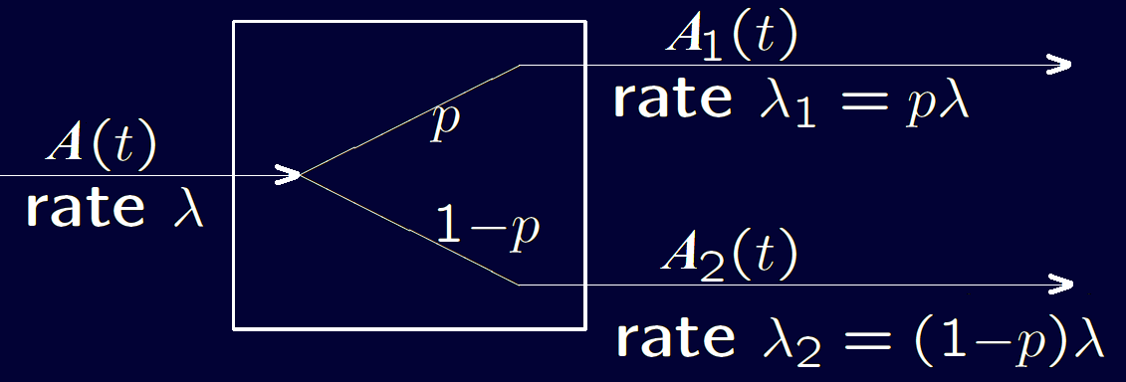
Splitting a Poisson Process
Arrival is switched to {A₁(t)} with probability p and otherwise goes to {A₂(t)}.
Switch is a Bernoulli process independent of {A(t)}.
  Flipping a p biased coin independently at each arrival.
Each new process has stationary and independent increment, and each satisfies the small increment property, thus is also Poisson.

Slide 7
Splitting a Poisson Process
Small increment property doesn’t guarantee the split processes are independent. Independence calls same small increments for both processes when they have arrivals.
Combining and splitting are often done together.
Example: A last-come first-serve queue with Poisson arrivals of rate λ , and independent exponential services of rate μ. New arrival gets service immediately, but will be interrupted by later “new arrival”.
  Both service & arrival are Poisson. Waiting is also Poisson of rate (λ + μ).
  Given you are interrupted, the probability of no more interruption
  μ² /(λ + μ) ².

Slide 8
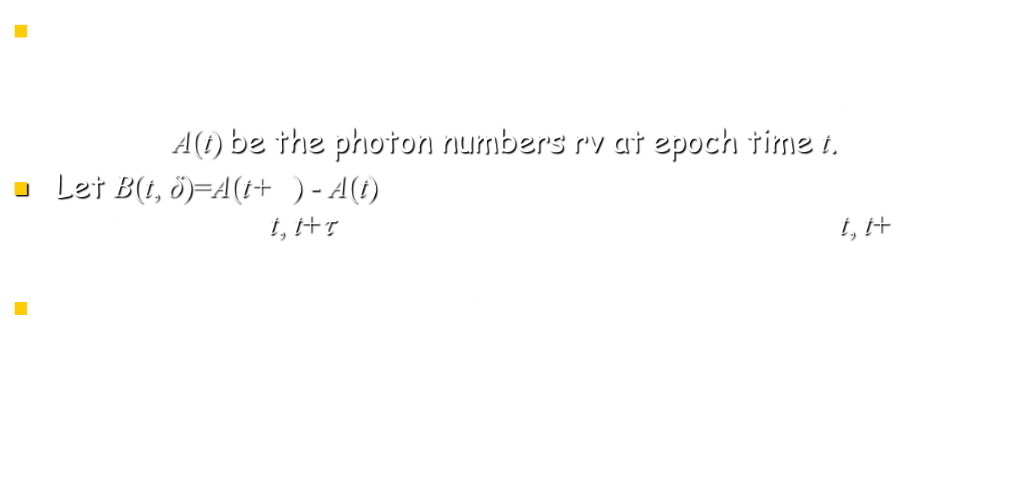


Non-homogeneous Poisson Processes

Slide 9

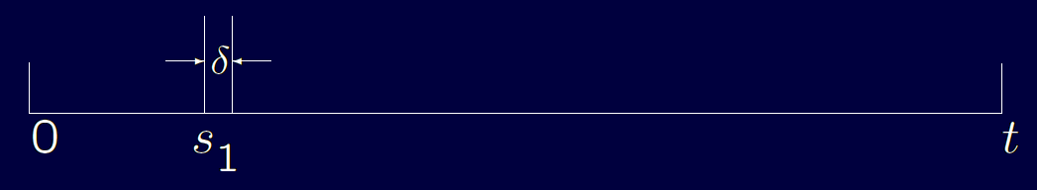
Conditional Arrival Densities
Treat increment B(0, t) =A(t) - A(0) as a Poisson process over (0, t] on condition A(t).
  When A(t)=1,
Distribution does not depend on s₁, uniform over (0, t]

Slide 10

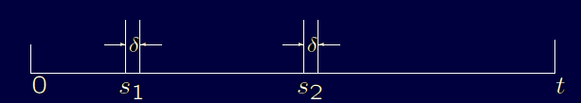
Conditional Arrival Densities
  When A(t)=2,
Distribution does not depend on s₁ or s₂ , still uniform over (0, t].

Slide 11

Conditional Arrival Densities
  When A(t)=N,
  Again uniform over 0< s₁ < …< s_{N} < t.
  Let U₁,... ,U_{N} be N iid uniform rv’s over (0, t]; S₁,... ,S_{N} be the order statistics for U, S_{n} = nth smallest among U. The volume of U is t ^{n} , density of U is nonzero partitions into n! regions that each one mapping to a ordered u₁,... ,u_{n} . Thus each partition is t ^{n}/ n! , each partition of S is also t ^{n}/ n!
  S stands for the N arrival epochs for A(t)=N, or the order statistics of N nonzero uniform iid rv’s (U₁,... ,U_{N} ).

Slide 12


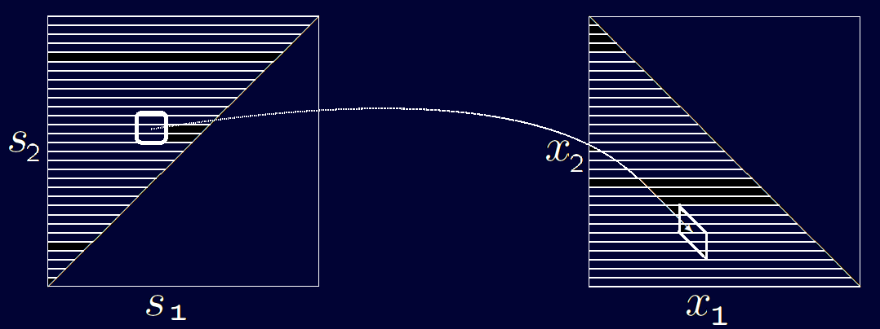
Conditional Arrival Densities
  On the condition of A(t)=N, find the distribution of S₁
  S₁ is the smallest one among U₁,... ,U_{N}
  When A(t)=2

Slide 13
From Poisson to Markov
Paradox: Mean interarrival time for Poisson process is 1/λ .
  But mean time from any given t to the next arrival is 1/λ ,
  Mean time back to the previous arrival is (1/λ)(1−e^{−λt}),
  Mean length of the interval containing t is (1/λ)(2−e^{−λt}).
  This Paradox is clearer when study renewals:
    Choose a sample path for a Poisson process and a uniform random value for t over some large interval far from 0.
    The larger inter-arrival intervals occupy proportionally more of the overall interval than the smaller.
    So t is biased to lie in one of those larger intervals.

Slide 14


Conditional Arrival Densities
Joint density of inter-arrivals X₁,... , X_{N} & arrival S_{N+1}
Both are uniform over the constraint region 0 < Σx_{k} <t .
Both are N-dimensional variable

Slide 15
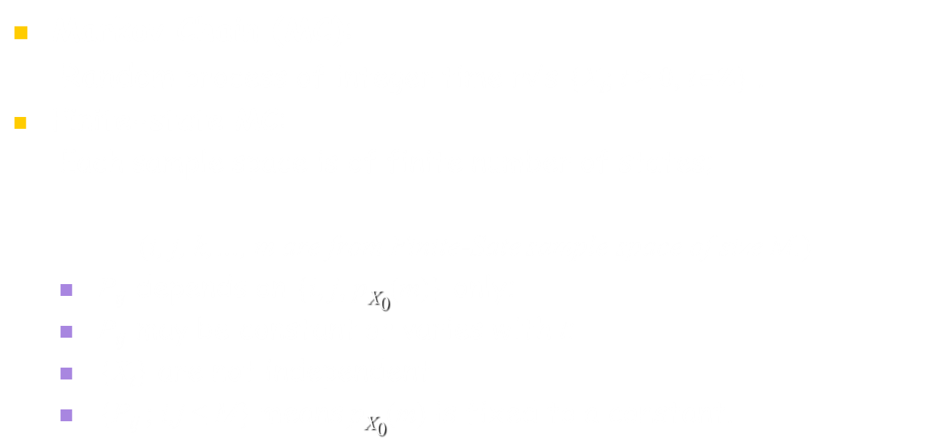
Finite-state Markov Chains

Slide 16

Finite-state Markov Chains
Directed Graph or Matrix are often used for
Chain Link Algebra Calculation
P₂₄
P₁₁
P₁₂
2
4
P₅₄
P₄₂
1
P₃₁
5
3
P₅₃
P₃₃

Slide 17
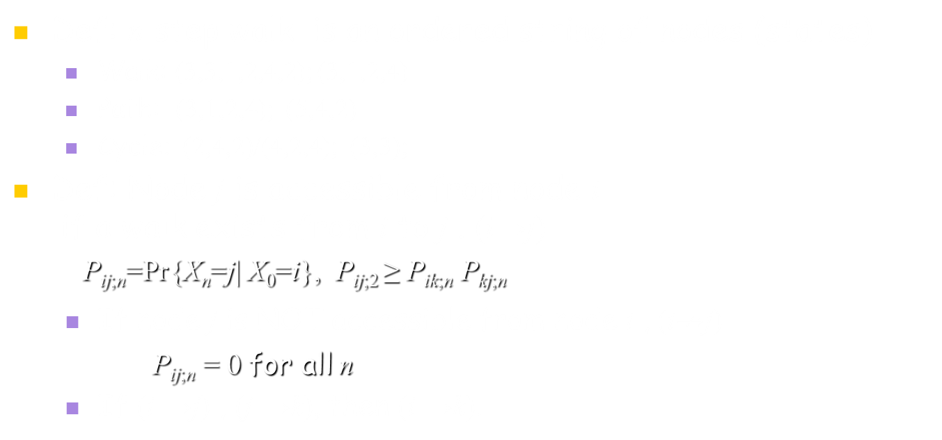
Classification of States
P₂₄
P₁₁
P₁₂
2
4
P₅₄
P₄₂
1
P₃₁
5
3
P₅₃
P₃₃

Slide 18
Classification of States
Def: States i, j communicate (ij), if (i→j) and (j→i).
  If (i  j) , (j  k), then (i  k).
  If (i  j), there must be a cycle
  containing both i , j states.
Def: A class of states C is not empty
  if each state i∈C communicates with every
  other state j∈C, but doesn’t communicate with j∉C.
  C₁={2, 4}, C₃={1}, C₁={5},
P₂₄
P₁₁
P₁₂
2
4
P₅₄
P₄₂
1
P₃₁
5
3
P₅₃
P₃₃

Slide 19
Classification of States
Def: State i is Recurrent if (j→i) for all j such that (i→j).
(ie. No state from which there is
no return can be entered.
Not recurrent = transient)
  (2, 4) are recurrent;
  (1, 3) are transient: (1→2, 3→2, 2  1,3)
Theorem:
The states in a class are all recurrent, or all transient.
P₂₄
P₁₁
P₁₂
2
4
P₅₄
P₄₂
1
P₃₁
5
3
P₅₃
P₁₃
P₃₃

Slide 20
Periodic State & Class
Def: The period d(i) of state i is: d(i)=gcd{n: P_{ii;n} >0}.
If d(i)=1, state i is aperiodic.
  P_{44;n} >0 for n=4,6,10; thus d(4)=2;
  P_{77;n} >0 for n=6,10,14,16; thus d(7)=2;
Theorem:
All states in the same class have same period.
Periodic class can be partitioned into sub-classes c₁,…,c_{K} so that: for i∈c_{k} , P_{ij} >0 only when j∈c_{k+1} ;
for i∈c_{K} , P_{ij} >0 only when j∈c₁ ;
1
9
8
2
4
7
3
5
6

Slide 21
Ergodic Markov Chian
Def: The recurrent & aperiodic states are Ergodic.
Markov chain with single ergodic state class is an ergodic
Markov chain.
Ergodic Markov chain gradually lose their
memory of where they start.
ie. P_{ij;n} goes to a limit _{j} >0 when n → .
Periodic class can be partitioned into sub-classes c₁,…,c_{K} so that: for i∈c_{k} , P_{ij} >0 only when j∈c_{k+1} ;
for i∈c_{K} , P_{ij} >0 only when j∈c₁ ;
6
5
1
4
2
3

Slide 22
Ergodic Markov Chian
P_{ij;n} → _{j} >0 when n → , is a weaker statement;
This is more combinatorial than probabilistic:
  Start form state 2, the state at next 4 step is
  deterministic. But the following step has
  2 choices (1,2) then 3.
Theorem: For an ergodic M state Markov chain,
P_{ij;n} >0 for all i, j, and n ≥ (M-1)²+1
6
5
1
4
2
3

Slide 23
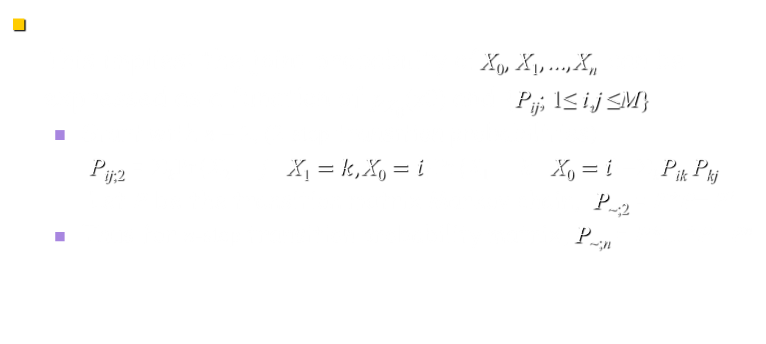
Ergodic Markov Chian

Slide 24
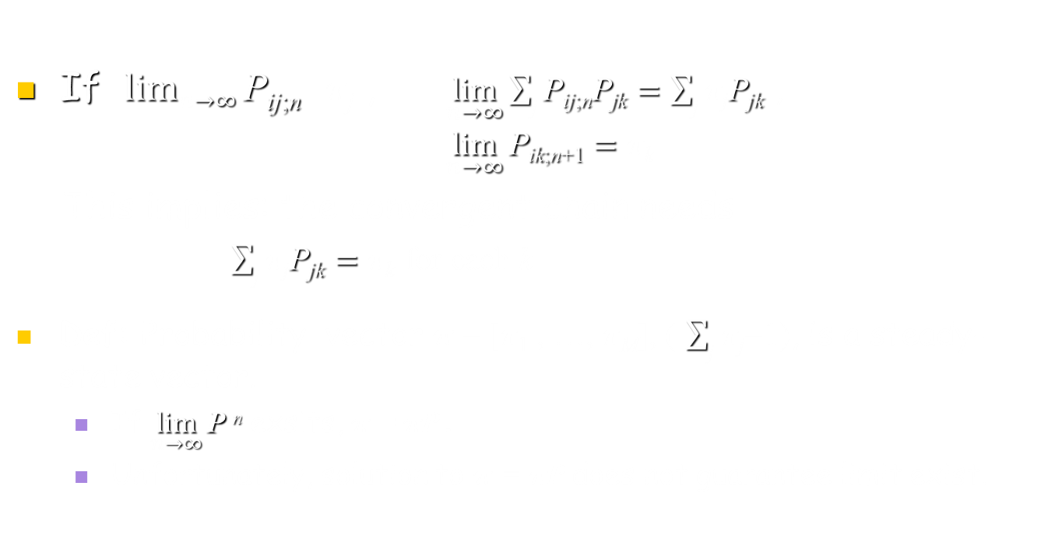
Convergence of P^{n}

Slide 25
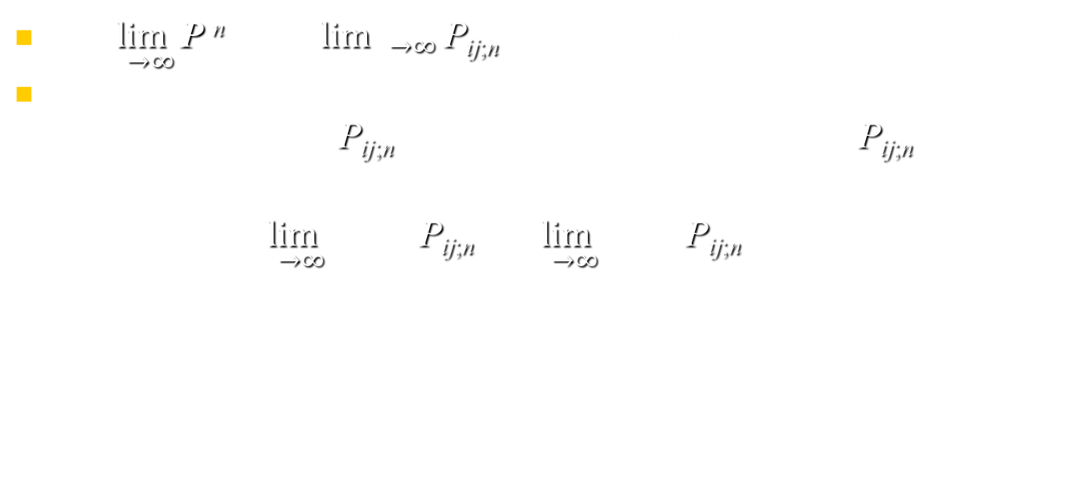
Ergodic Markov Chain

Slide 26
Ergodic Markov Chain
Lemma1: Let P be transition matrix of arbitrary finite-state Markov chain. Then for each j,
max_{i}{P_{ij;n}} is nonincreasing in n;
min_{i}{P_{ij;n}} is nondecreasing in n.
Eg1: Consider 2-state chain with P₁₂ = P₂₁ =1.
Then P_{12;n} alternates between 1&0 for increasing n; while P_{22;n} alternates between 0&1.
The maximum of P_{12;n} & P_{22;n} is 1, nonincreasing, and the minimum is 0.
Information & Telecommunication Engineering (0900203) @ SDUWH

Slide 27
Ergodic Markov Chain
Eg2: Consider 2-state chain with P₁₂ = P₂₁ =3/4. Then P_{12;n}=3/4,3/8,9/16,… for increasing n; while P_{22;n} =1/4,5/8,7/16,… .
  Each sequence oscillates while approaching 1/2;
  max{P_{12;n}, P_{22;n}}= 3/4,5/8,9/16,…., which is decreasing toward 1/2;
  min{P_{12;n}, P_{22;n}}= 1/4,3/8,7/16,…., also approaches 1/2 from below.
Information & Telecommunication Engineering (0900203) @ SDUWH

Slide 28
Ergodic Markov Chain
Lemma1 Proof: For any sates i, j and step n,
P_{ij;n+1} =Σ_{k} P_{ik}P_{kj;n} ≤ Σ_{k} P_{ik}max_{l}{P_{lj;n} }=max_{l}{P_{lj;n}}
  This holds for all i , so max_{i}{P_{ij;n+1}} ≤ max_{l}{P_{lj;n} }
  Thus min_{i}{P_{ij;n+1}} ≥ min_{l}{P_{lj;n} } (Existence)
Lemma2: Let P >0 be transition matrix of finite-state Markov chain, α = min_{i,j}{P_{ij}} , then for all j and step n≥1,
(max_{i}P_{ij;n+1}-min_{i}P_{ij;n+1}) ≤ (max_{l}P_{lj;n}-min_{l}P_{lj;n})(1-2α )
(max_{l}P_{lj;n}-min_{l}P_{lj;n}) ≤ (1-2α )^{n}
lim_{n→∞}max_{l}P_{lj;n}= lim_{n→∞}min_{l}P_{lj;n} >0 (Equality)
Information & Telecommunication Engineering (0900203) @ SDUWH

Slide 29
Ergodic Markov Chain
Lemma2 Proof: For given j & n, let lmin be a state that minimizes P_{ij;n} over i. Then
P_{ij;n+1} =Σ_{k} P_{ik}P_{kj;n} ≤ Σ_{k≠lmin} P_{ik}max_{l}P_{lj;n} +P_{ilmin}min_{l}P_{lj;n}
=(1-P_{ilmin} ) max_{l}P_{lj;n} +P_{ilmin}min_{l}P_{lj;n}
= max_{l}P_{lj;n} –P_{ilmin}(max_{l}P_{lj;n} - min_{l}P_{lj;n})
≤ max_{l}P_{lj;n} – α (max_{l}P_{lj;n} - min_{l}P_{lj;n})
Thus max_{i}P_{ij;n+1} ≤ max_{l}P_{lj;n} – α (max_{l}P_{lj;n} - min_{l}P_{lj;n}) and
min_{i}P_{ij;n+1} ≥ min_{l}P_{lj;n} – α (max_{l}P_{lj;n} - min_{l}P_{lj;n})
max_{i}P_{ij;n+1} - min_{i}P_{ij;n+1} ≤ (1-2α) (max_{l}P_{lj;n} - min_{l}P_{lj;n}) (#1)
Information & Telecommunication Engineering (0900203) @ SDUWH

Slide 30
Ergodic Markov Chain
… max_{i}P_{ij;n+1} - min_{i}P_{ij;n+1} ≤ (1-2α) (max_{l}P_{lj;n} - min_{l}P_{lj;n})
max_{l}P_{lj} ≤ (1-α) & min_{l}P_{lj} ≥ α
∴ max_{l}P_{lj} - min_{l}P_{lj} ≤ (1-2α)
iterating on n …
∴ max_{l}P_{lj;n} – min_{l}P_{lj;n} ≤ (1-2α)^{n} (#2)
Let P^{h} =Q , α = min_{i,j}{Q_{ij}} , then we need proof
max_{l}Q_{lj;n} & min_{l}Q_{lj;n} have same limit, so as to
max_{l}P_{lj;h+n} & min_{l}P_{lj;h+n} , Thus
lim_{n→∞}max_{l}P_{lj;n}= lim_{n→∞}min_{l}P_{lj;n} =π_{l} >0 (#3)
Information & Telecommunication Engineering (0900203) @ SDUWH

Slide 31
Ergodic Unichains
Since lim_{n→∞}P_{ij;n} =π_{j}  i , vector π ={π_{j} : j=1, 2, 3,…} is a steady-state vector with π P=π .
The extension of this leads to Ergodic Unichains that containing single ergodic class along with arbitrary set of transient states.
If a state is of singleton transient class, there is a fixed probability, α, of leaving the class at each step, and the probability of remaining in the class for more than n steps is (1 − α)^{n}.
Information & Telecommunication Engineering (0900203) @ SDUWH

Slide 32
Ergodic Unichains
The probability of remaining in an arbitrary set of transient states will finally decay to 0 .
  Each transient state has at least one path to a recurrent state;
  One of those paths must be taken eventually;
For an ergodic unichain, the ergodic class is eventually entered, then steady state in that class is reached.
For every state j,
lim_{n→∞}max_{i}P_{ij;n}= lim_{n→∞}min_{i}P_{ij;n} =π_{j}
  π_{j} = 0 for each transient state, while
  π_{j} > 0 for each recurrent state.
Information & Telecommunication Engineering (0900203) @ SDUWH

Slide 33
Other finite-state Markov Chains
Consider a Markov chain with several ergodic classes, C₁,..., C_{m} , which don’t communicate to each other.
For the entire chain, P will have m independent steady state vectors.
P ^{n} will converge, but the rows will not all be the same.
  There will be m sets of rows, one for each class;
  Row for class k will be nonzero only for the elements of that class.
Information & Telecommunication Engineering (0900203) @ SDUWH

Slide 34
Other finite-state Markov Chains
Consider a periodic recurrent chain of period d , which can be separated into d subclasses with a cyclic rotation between them.
If we look at P ^{d}, each subclass becomes an ergodic class, C₁,..., C_{d} , thus lim_{n→∞}P ^{nd} exists.
A steady state is reached within each subclass, but the chain rotates from one subclass to another.
Information & Telecommunication Engineering (0900203) @ SDUWH

