Slide 1

Discrete Stochastic Processes
Lecture 08
________________________________________________________________________________________
2020 Autumn @ SDUWH

Slide 2
Convergence & Poisson Process
Probability Models
Markov, Chebychev, Chernoff bounds
Weak law of large numbers & convergence
Central limit theorem & convergence
Convergence with probability 1
Arrival process vs Poisson process
Stationary independent increment
Relation to Bernoulli process

Slide 3
Probability in the real world
Probability Model is built with Trials that:
  have same initial Conditions
  isolated from each other
  have fixed set of outcomes
  have ‘random’ individual outcomes
Model can be extended for n-tuple iid rv
  Sample frequency & average (deterministic) ↔ LLN ↔ True probability & expectation (stochastic)

Slide 4
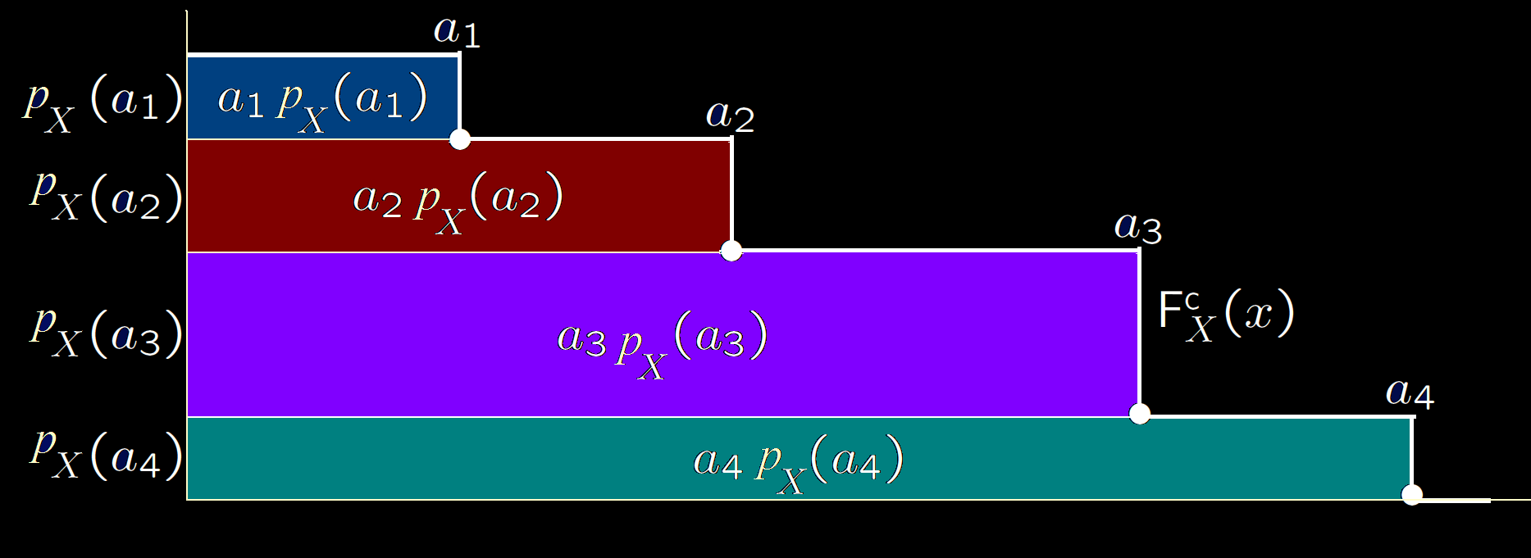
Markov, Chebychev, Chernoff bounds
Complementary distribution function
F^{c}_{X}(x) = Pr{X > x}

Slide 5
Markov, Chebychev, Chernoff bounds
Markov inequality: If Y is a non-negative rv with E[Y], then for ∀ y>0,
  Pr{Y>y} ≤ E[Y]/y (∝ 1/y)
Notes:
Markov bound is very loose, expect for binary Y.

Slide 6

Markov, Chebychev, Chernoff bounds
Notes:
Markov bound is very loose, expect for binary Y.

Slide 7
Markov, Chebychev, Chernoff bounds
Chernoff inequality: Any z>0 r>0, the moment generation function g_{Z}(r)=E[e^{rZ}],
  Pr{Z ≥ z} ≤ g_{Z}(r)e^{-rz} (∝ 1/e^{z})
Proof: Let Y = e^{-rZ} , ∴E[Y]= g_{Z}(r) .
Pr{Y ≥ y }≤ g_{Z}(r) / y
Let y = e^{-rz} ,∴Pr{e^{-rZ} ≥ e^{-rz} }≤ g_{Z}(r) / e^{-rz} , #
Notes:
useful in studying large deviations from the mean.

Slide 8

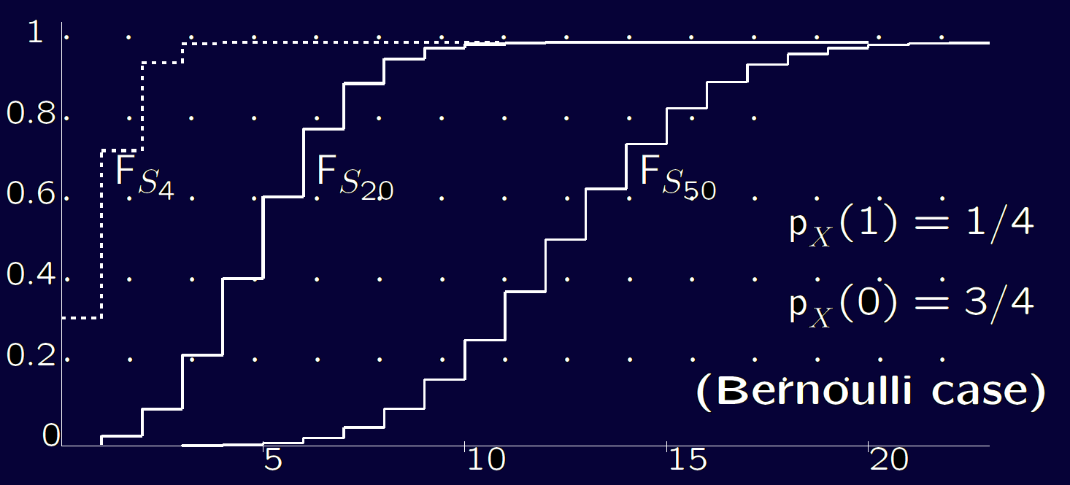
Law of Large Number & Convergence

Slide 9

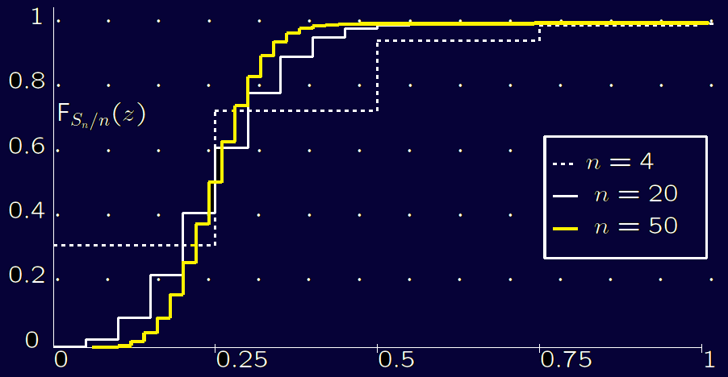

Law of Large Number & Convergence

Slide 10
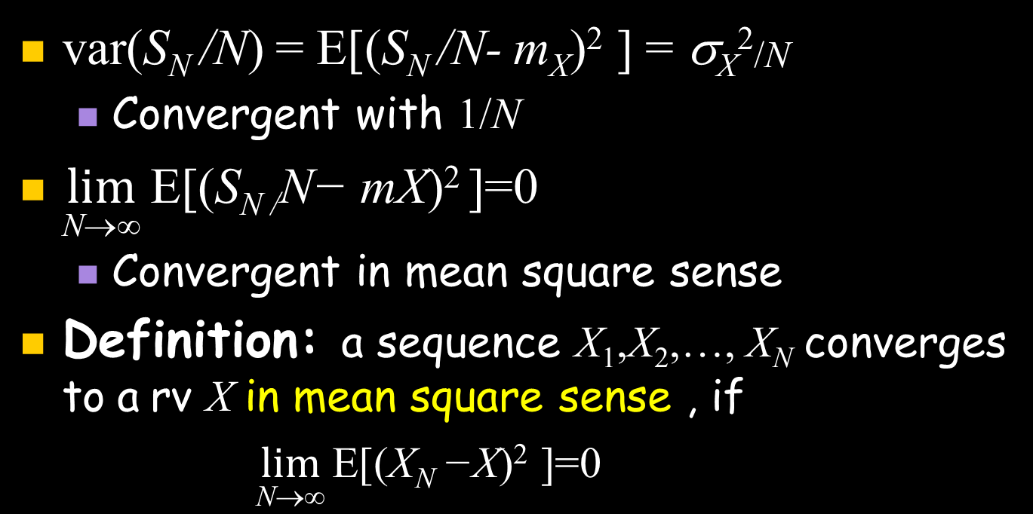
Law of Large Number & Convergence

Slide 11
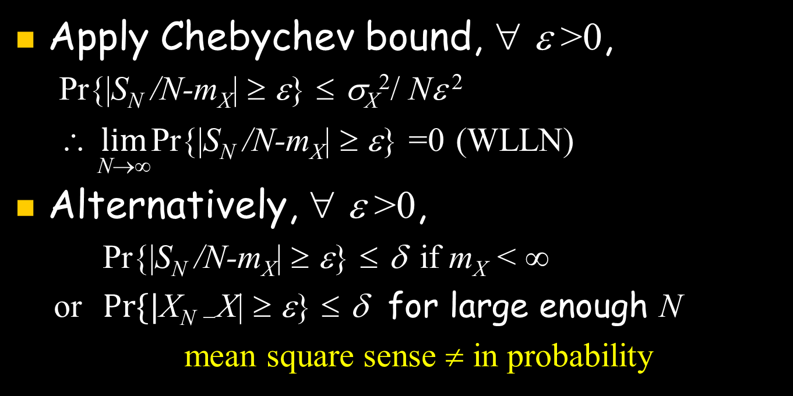
Weak Law of Large Number & Convergence
Notes:
mss < ip

Slide 12

Weak Law of Large Number & Convergence
Notes:
CLT: Y_{N} converges in distribution to N

Slide 13

Convergence with Probability 1

Slide 14
Perfect Arrival Processes (Poisson)
Def: An arrival process is an increasing rv sequence 0 < S₁ < S₂<…, i.e. X_{i} = S_{i} - S_{i-1}>0, F_{Xi} (0) = 0.
  X_{i} : increment / interval time; S_{i} : epoch
  A(t) : the number of
  arrivals in (0,t]
  {A(t); t>0}: arrival
  counting process
A(t)
X₃
X₂
X₁
s₁ s₂ s₃ t
Notes:
Nonevent sample is weird, usually ignorable.

Slide 15
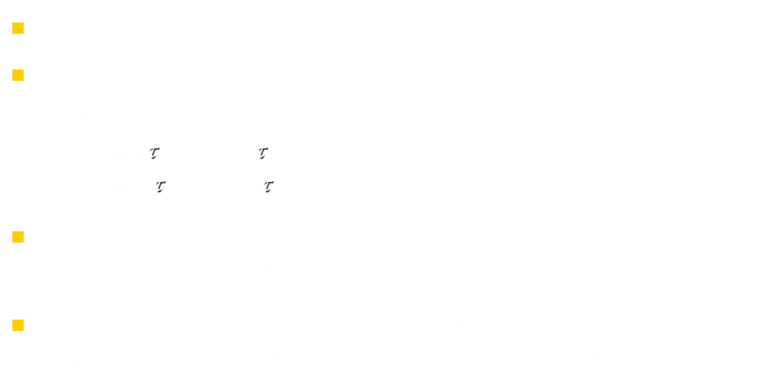
Perfect Arrival Processes (Poisson)
A(t)
X₃
X₂
A(τ)
X₁
s₁ s₂ τ s₃ t
Notes:
Nonevent sample is weird, usually ignorable.
The last is ho-hum but useful for limits.

Slide 16
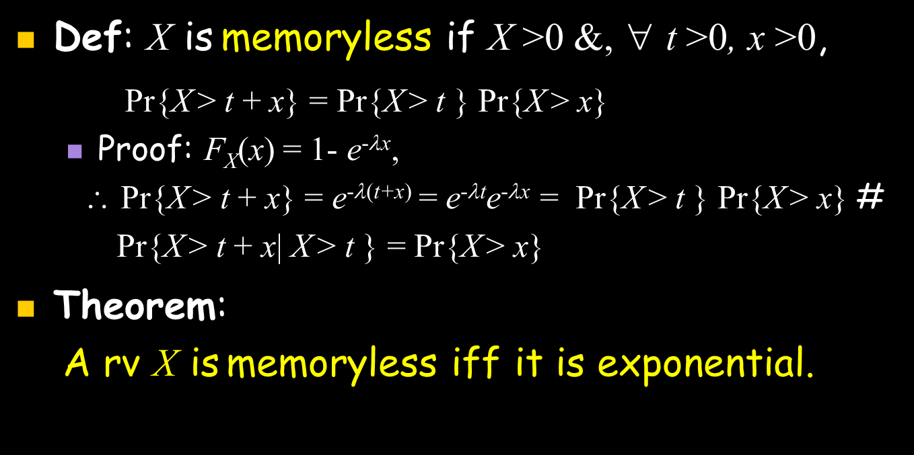
Poisson Process & Exponential rv

Slide 17
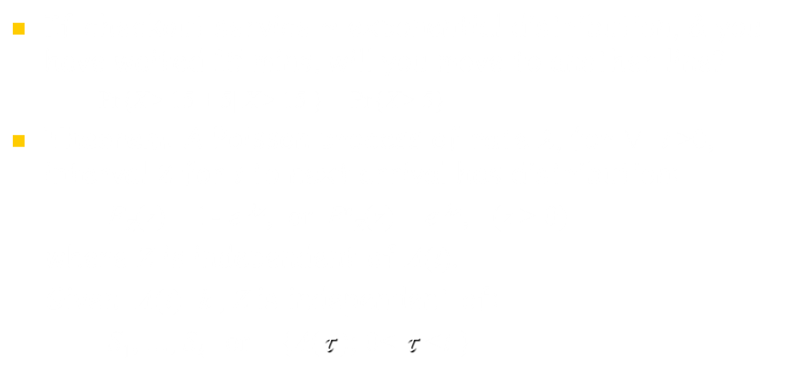
Poisson Process & Exponential rv
[A(t+τ) - A(t)] & A(τ)
are of also same iid
distribution

Slide 18
Stationary & independent increments
Def: A counting process {A(t); t > 0} has the stationary increment if A(t+τ) − A(t) has the same dis­tribution as A(τ ) for all τ > 0.
  Arrival increment within τ time is independent of start point, has the same distribution as A(t) does.
Def: A counting process {A(t); t > 0} has the stationary increment if for ∀ t₁, t₂, ..., t_{k} , A(t₁)-A(0), A(t₂)−A(t₁), ..., A(t_{k})−A(t_{k-1}) are independent.
Poisson processes have stationary and inde­pendent increments.

Slide 19

Erlang & Poisson Distributions

Slide 20

Erlang & Poisson Distributions

Slide 21

Relation to Bernoulli Process

